Slide 1


WELCOME ABOARD!
New Employee Orientation
Beth Israel Deaconess Hospital Milton

Slide 2

Introductions
Take a minute now to introduce yourselves to your new co-workers.
Name
Department / Position
New Employee Orientation
2

Slide 3
Today’s Objectives
We want you to leave here today -
  Excited to be a part of the Beth Israel Lahey Health system.
  Looking forward to supporting BID-Milton’s mission, and goals.
  Knowledgeable about our policies and staff member responsibilities.
  Able to identify information, resources and tools available to help you do your job.
  Familiar with programs and initiatives designed to support you and our patients.
  Feeling like a welcome and valued member of our BILH and BID-Milton family!
New Employee Orientation
3

Slide 4
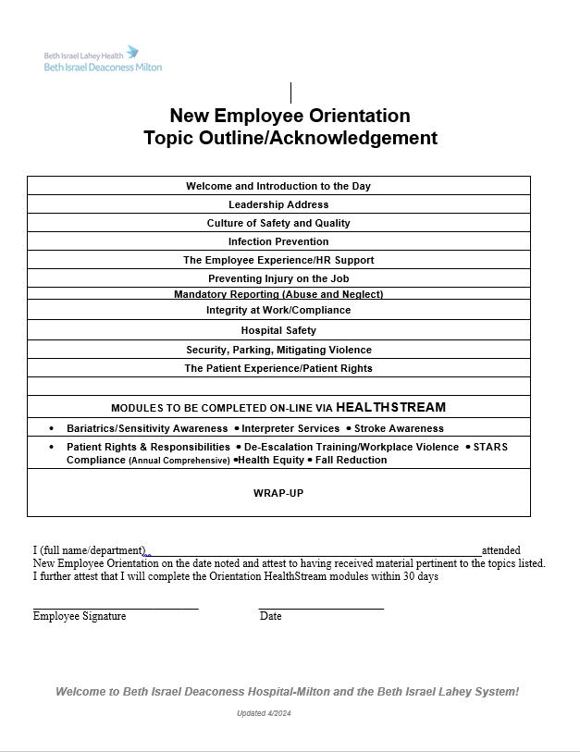
Agenda
8:00am
12:30pm: Then badges
New Employee Orientation
4

Slide 5
Expectations for the Day
To establish a positive learning environment please:
Listen attentively, participate actively in discussions.
Set pagers/cell phones to silent or vibrate.
Refrain from texting/checking e-mail/social media, etc.
Return from break promptly.
Housekeeping
Restroom location.
ID badges
  will be obtained later today
  wear your badge at all times on the top third part of your body.
New Employee Orientation
5

Slide 6

Orientation Packet
-Orientation Day Presentation Slides
-Orientation Learning Assessment
-Orientation Evaluation
-Ergonomics Tips Handout
-How to Access Healthstream
-All Policies
-Topic Outline/Acknowledgement
-2025 Summary of Benefits
-How to Elect Benefits in Workday
-Workday New Hire Onboarding Tips
-KGA Employee Assistance Program
- G.R.E.A.T. Service Excellence
-WeCare Values
New Employee Orientation
6

Slide 7

Leadership Address
Welcome to BID-Milton and BILH
New Employee Orientation
7

Slide 8

BILH: Celebrating 5 Years!
Celebrating Five Years of BILH (vimeo.com)
New Employee Orientation
Notes:
00:11- 00:13
AN INTRODUCTION TO BILH FROM DR. KEVIN TABB
As you heard from Dr. Tabb, we’ve got a tremendous opportunity ahead to do things that no one else has done and to make our dreams a reality for our patients and that’s anyone who walks into our doors.
Keep your eyes out for Dr. Tabb’s monthly BILH newsletter where we all have an opportunity to hear first hand key information about our system development.
You may be wondering about this blue logo? Some have said it reminds them of a bird in flight, or even origami.
The link below to the 1 minute 15 second video is embedded in the slide: https://www.youtube.com/watch?v=SOAbfUncV34&feature=youtu.be

Slide 9

Beth Israel Lahey Health was established on March 1, 2019. Together, we are creating an integrated health care system that:
Provides high-quality, care close to where
our patients live and work
Invests in and strengthens local hospitals and
community-based care
Works to keep our patients healthy and care for them
in their communities
Advances the science and practice of medicine by investing
in research and education
Embraces a new model of care that helps contain rising
health care costs
Creates a workplace that engages and develops the best people
New Employee Orientation
Notes:
00:00 - 00:01
WHY ARE WE CREATING AN INTEGRATED HEALTH SYSTEM AND WHY NOW
Welcome to BIDMC and welcome to BILH—that’s short for Beth Israel Lahey Health, our regional system that came together only ______ months ago!
How many of you are familiar with BILH? Curious, what have you heard? (Take responses, validate, clarify, etc.)
We believe that there is a better way to deliver care to our patients, work to keep our communities healthy—and develop our professional careers at the same time because our opportunities to learn are expansive.

Slide 10
Beth Israel Lahey Health…
is a comprehensive, geographically distributed network of:
9 excellent community hospitals;
4 world class academic medical centers and teaching hospitals;
1 premier orthopedics hospital;
Behavioral health services;
Continuing care services;
4,300 physicians – including 800 primary care physicians; and
Over 35,000 employees.
Regionally and nationally renowned programs in cancer, cardiovascular medicine, gastroenterology, home health, orthopedics, substance abuse treatment, surgery, women’s health and more.
New Employee Orientation
Notes:
00:02 – 00:05
WHAT KINDS OF ORGANIZATIONS AND HOW MANY STAFF/MDS SUPPORTING OUR PATIENTS AND KEY SPECIALTIES
You can see here that we have different types of healthcare organizations:
8 Community hospitals, so critical to the communities they serve
4 Academic medical centers and teaching hospitals, where beyond patient care, you’ll find interns, residents and fellows pursuing education, and where research is being conducted
1 hospital that specializes in orthopedics (for hip and knee replacements and more)
Behavioral health services providing high-quality mental health and addiction treatment. This includes a full continuum of care for children and adults ranging from inpatient to community-based services (e.g., mobile emergency services teams, school and home based counseling for youth and their families.)
Continuing care services that offer patients support following their hospital stay, during recovery, or to assist with end-of-life needs… all as close to home as can be safely managed.
We have 4,300 physicians; the majority are specialists in cardiology, cancer care, surgery, etc. We’re also incredibly proud of our vast number of primary care physicians who we believe form the backbone of health and well-being.
Our areas of expertise literally cover every major medical specialty, including Level 1 trauma. (Highlight some of those listed on the slide)
The take-away is the concept of “regional.” Our goal is for Massachusetts residents to be within 5 miles of a healthcare provider.
And, with 35,000 of us strong, we are officially the 2nd largest employer in the state of Massachusetts!
By the way, it’s also fun to know that NE Baptist is the official hospital of the Boston Celtics and BIDMC is the official hospital of the Red Sox and Lahey is the official hospital of the Bruins!

Slide 11
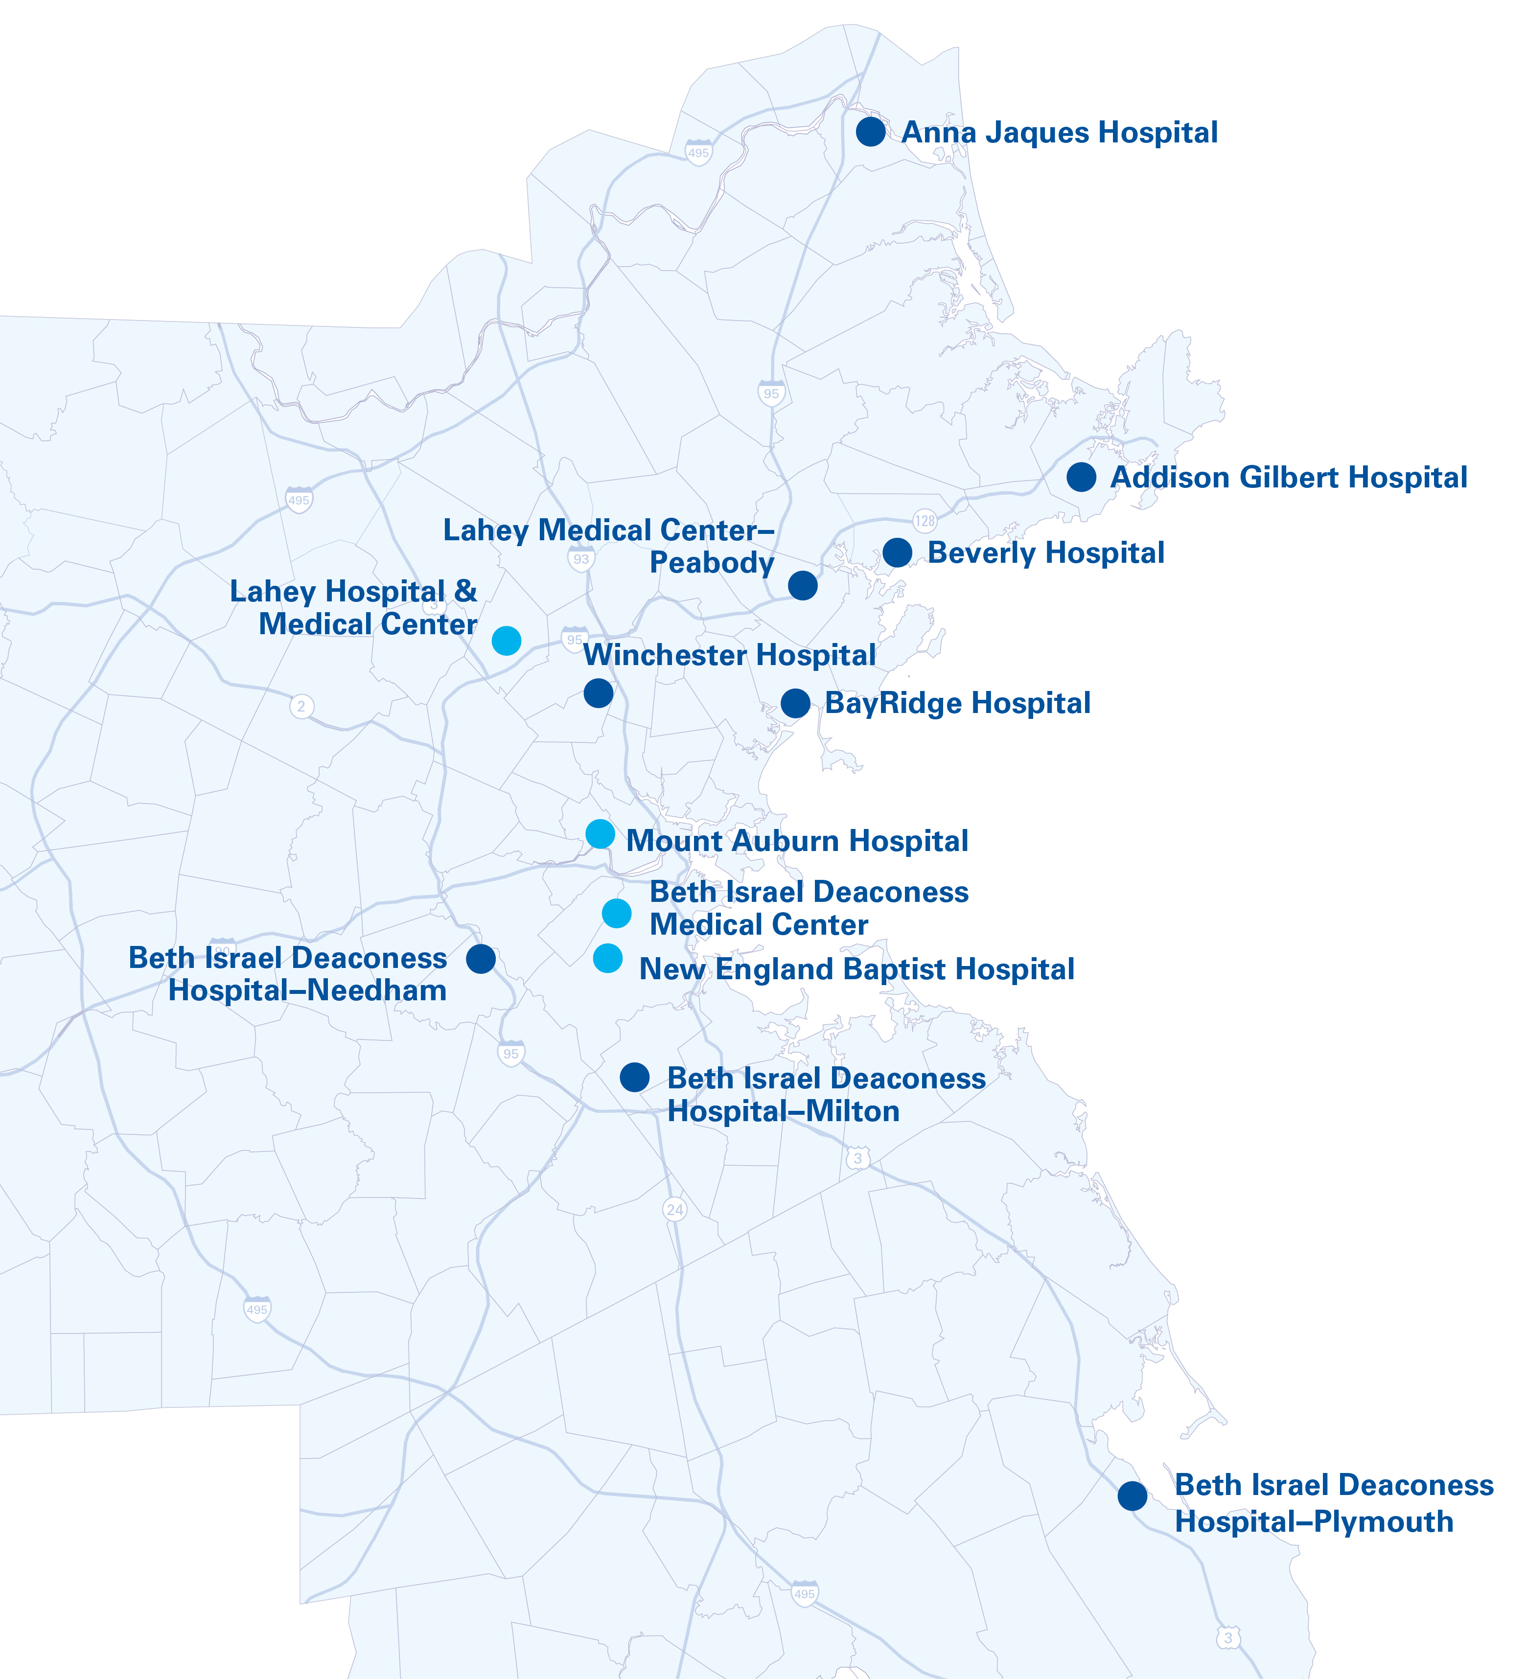
Exeter Hospital
New Hampshire
Member Hospitals
Community hospitals
Academic medical centers and teaching hospital
New Employee Orientation
Notes:
00:05 - 00:07
OUR GEOGRAPHY
This map of Eastern Massachusetts gives you a good look and feel for the BILH member hospitals and where we’re located.
From the North Shore as far as Newburyport (Anna Jaques) to the South Shore (BIDH-Plymouth) to the western suburbs to Boston and Cambridge.
All 13 Hospitals are shown here. What you don’t see are the numerous other types of patient care services and sites that are part of BILH, some of which were highlighted on the last slide. (HCs, Primary Care Practices, etc.)
You’re also not seeing Med flights bringing the sickest patients to our trauma centers. You don’t see our Nurses and Medical Technologists and Practice Assistants and Researchers and Programmers and Social Workers and IT Associates ... All of us, working to create a place we can be proud of, within a unique culture that is richly diverse and inclusive of all.
So how do we organize a large system like ours to function effectively and efficiently?

Slide 12
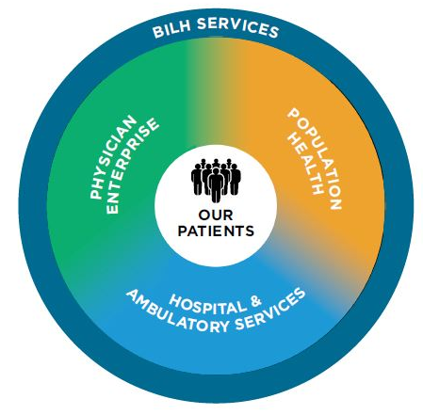
Beth Israel Lahey Health Operating Model
Administrative and operational services and functions that are shared across the system to achieve greater efficiency and effectiveness
System network of employed physicians throughout our region
Clinically integrated network (BILPN)
Behavioral health
Continuing care
Academic medical centers
Teaching hospitals
Specialty hospitals
Community hospitals
Ambulatory centers
New Employee Orientation
Notes:
00:07 – 00:11 HOW DOES BILH OPERATE/WORK TOGETHER TO ACHIEVE SYSTEM GOALS
You’ll see 4 key areas that when in concert, produce an integrated system. No, we’re not there yet and full integration will no doubt take several years to achieve.
Let’s begin here, with the “bricks and mortar”, the actual places where care occurs—our Hospitals and Ambulatory Services.
Our Physician Enterprise, which is over 4,300 providers with a full range of specialty and primary care backgrounds. No healthcare system can function without them, right?
Moving to Population Health—this is about our commitment to improving patient outcomes and experience, as well as the overall management of healthcare costs. As we understand our patients across the system, we’ll be in a better position to be proactive to address those risk factors that can develop into disease. Ultimately, it’s about helping all our patients and communities be healthier.
Part of Population Health focuses on Behavioral Health services, and one area of focus is Opioid Addiction, and its devastating impact across the state.
Another focus is providing continuing care options our patients need as they leave hospitals.
BILH Services is much of the infrastructure engine for how we keep our systems and processes running. It’s here that we can be a better learning organization by sharing best practices in HR, IT, Finance, Development, Communications/Marketing, and Legal areas. At the same time, we can achieve economies of scale so that we’re not reinventing the wheel from place to place.
Let me pause here—what questions are coming up for you?
I’d like to take a moment now to introduce you to Dr. Kevin Tabb, the President & CEO of Beth Israel Lahey Health, in this very short video.

Slide 13

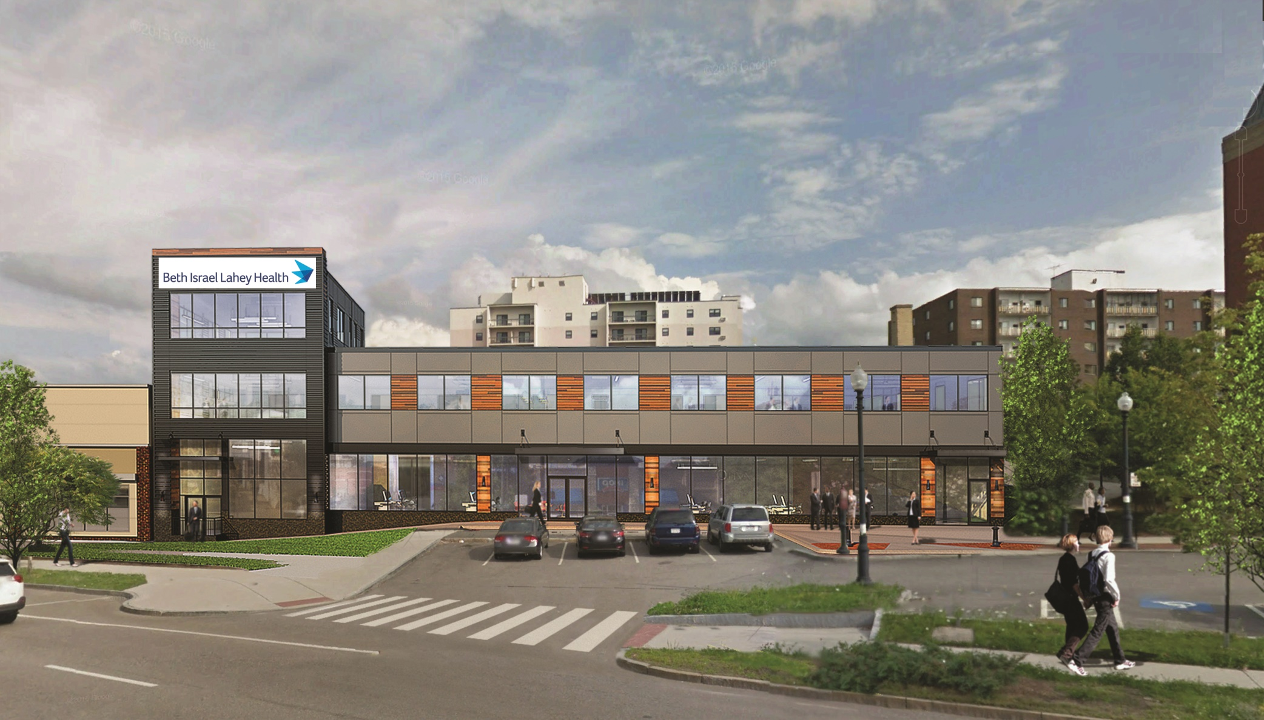
BID-Milton: Timeline
2018
12 new private rooms and 7th OR opened, surgery program expands with robotic surgery
2009
Expanded relationship with Atrius Health to establish a new model of health care delivery
2012
Joined the Beth Israel Deaconess Medical Center (BIDMC) system as a corporate affiliate
Today
A 100 bed leading regional community hospital; 600 physicians on staff; 42,000 ED visits and >1,000 joint replacements annually
2019
Became part of the Beth Israel Lahey Health System
1903
Milton Hospital incorporated with
9 beds
1944
Hospital moves to current site
1993
New wing of the medical office building built
…we’re poised to change the face of health care, with an emphasis on the right care, delivered at the right place, at the right time.
Quincy Urgent Care Center
October 2020
New Employee Orientation
13

Slide 14
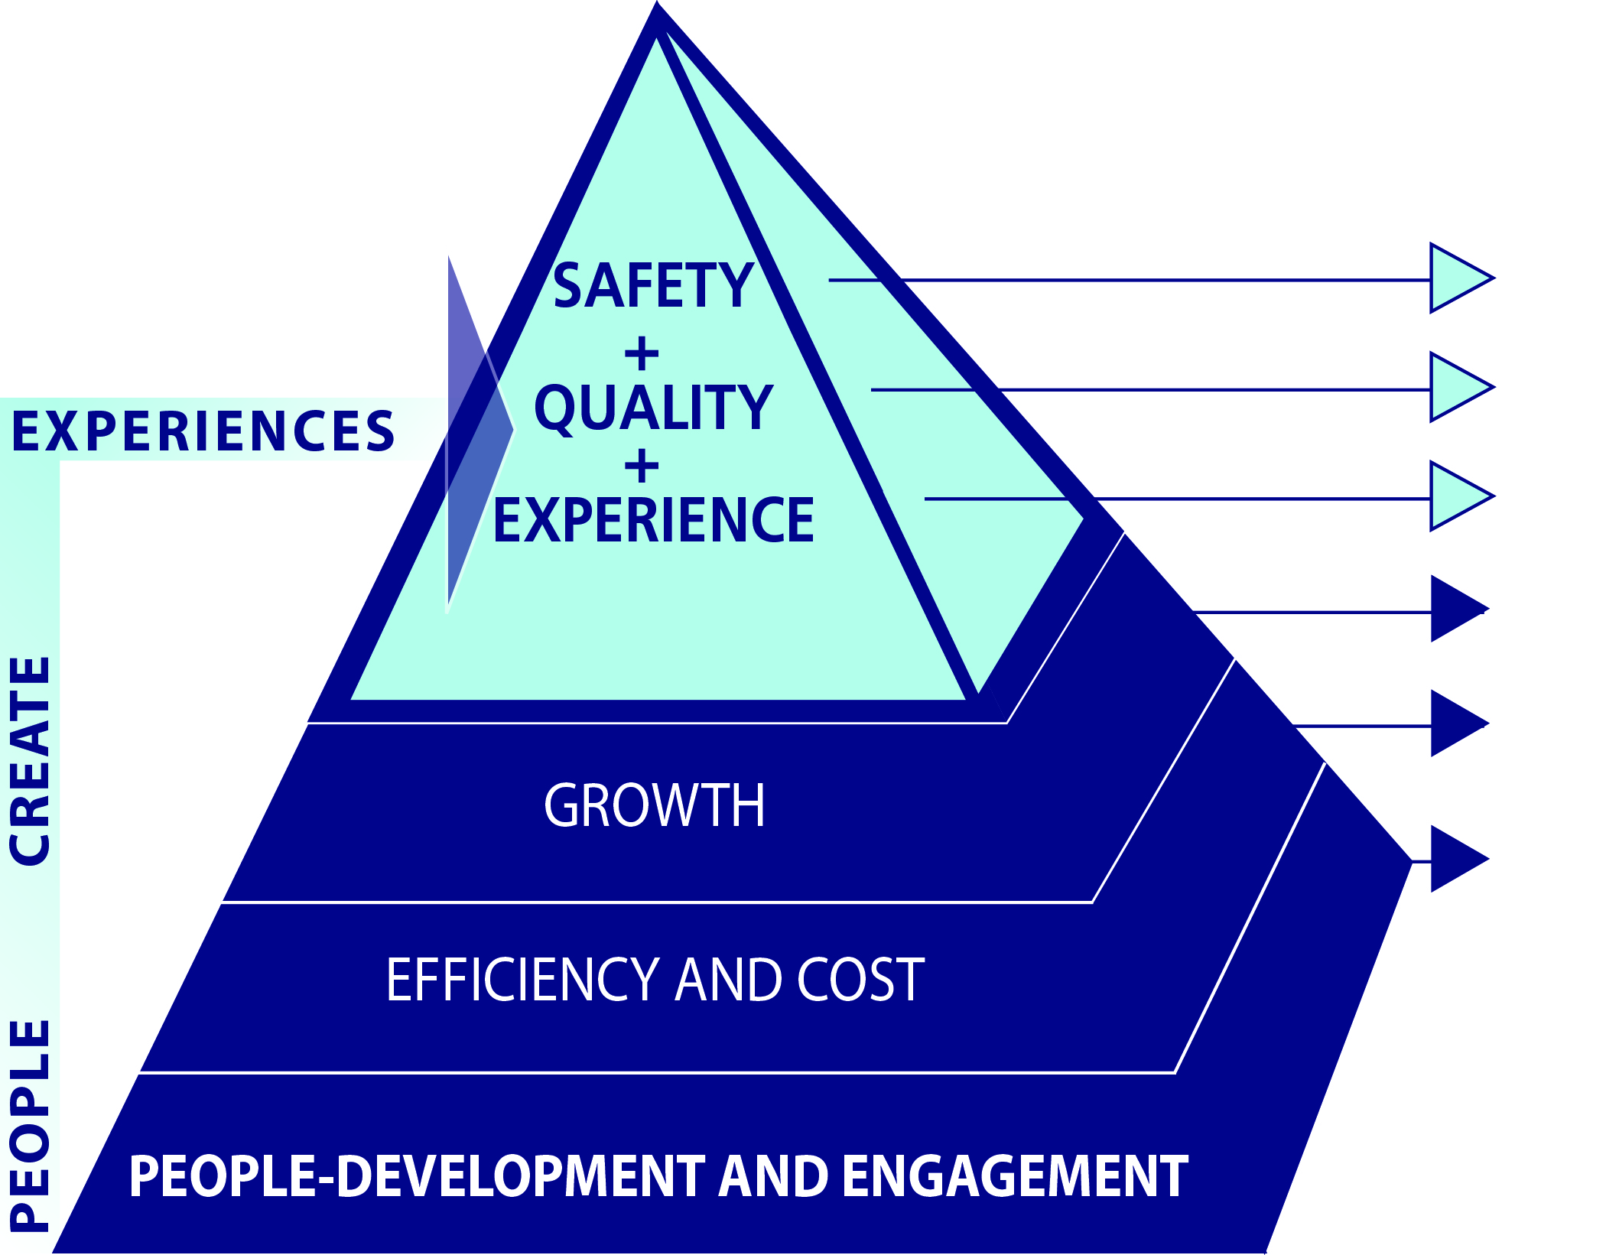
Beth Israel Deaconess Milton Mission
To improve the health of our community by providing exceptional, personalized care with dignity, compassion and respect.
First, do no harm
Implement best practices
Anticipate and exceed expectations
Expand market share and clinical services
Eliminate waste
Support those who make up our foundation
New Employee Orientation
14

Slide 15

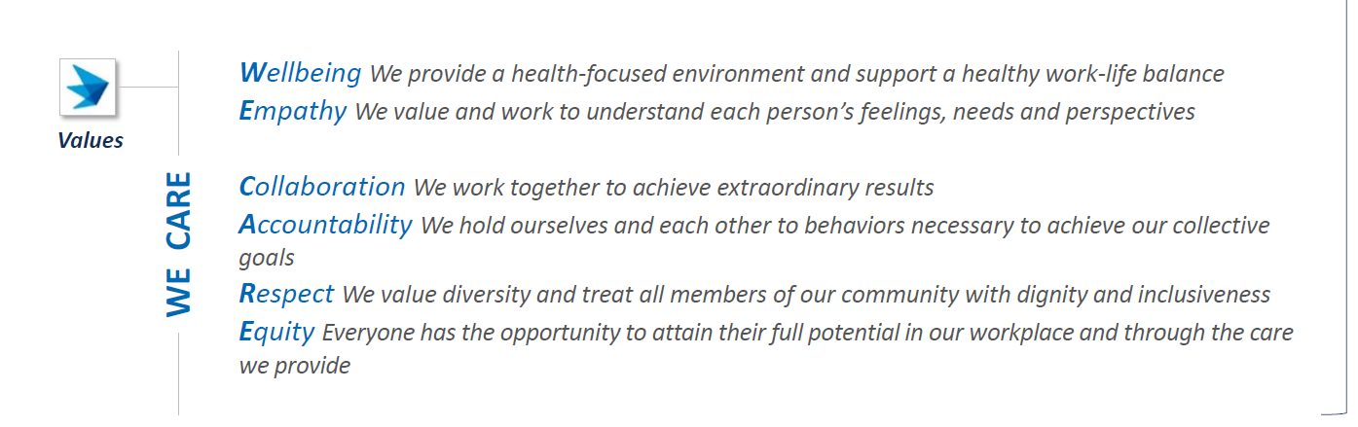
We’re a “Purpose-Driven, Values Based” Organization
New Employee Orientation
15

Slide 16








Quality and Safety
2023-2024
Top Hospital in Heart/Kidney Failure & COPD
26 BID Milton Physicians on this list!
New Employee Orientation
16

Slide 17
Healthcare Quality and Patient Safety
New Employee Orientation
17

Slide 18
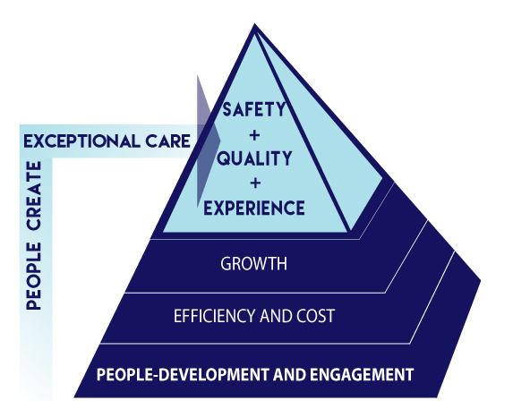

Patient Safety at BID-Milton
New Employee Orientation
18

Slide 19

Safety Culture
The Joint Commission defines Safety Culture as “the product of individuals and group beliefs, values, attitudes, perceptions, competencies and patters of behavior that determine the organizations’ commitment to quality and patient safety”
New Employee Orientation
19

Slide 20
BID-Milton’s Culture of Safety
The hospital:
Acknowledges the high-risk nature of its activities and is committed to consistently providing safe, error free care;
Creates a blame-free environment where individuals are able to report errors and near miss events without fear of reprimand or punishment;
Encourages collaboration across all levels and disciplines to seek solutions to identified risks in patient care processes; and
Is committed to making resources available and to design effective and resilient systems to address safety opportunities.
New Employee Orientation
20

Slide 21

Adverse Events and Safety Risks
Adverse event: a patient safety event that resulted in harm
Adverse Events < 1%
Known
Safety Risks: Close calls, safety, near misses, no harm, or good catches
Unknown
New Employee Orientation
21

Slide 22

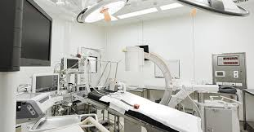
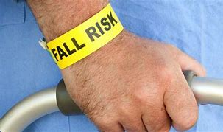
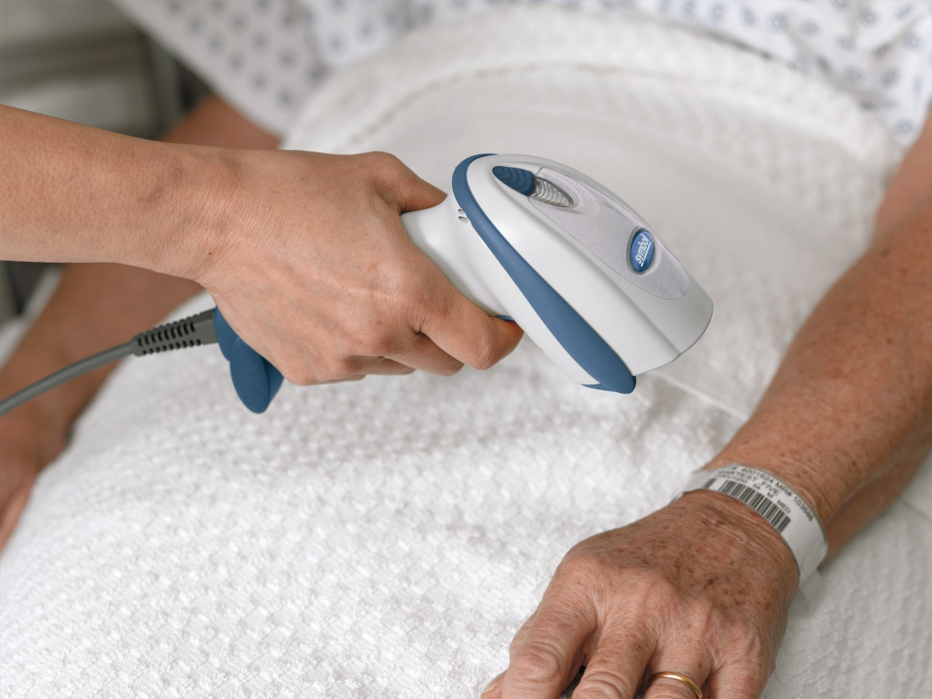
Examples of Safety Risks
Equipment
Malfunction
Hand Off Communication
Failures
Patient Falls
Medication Errors
New Employee Orientation
22

Slide 23
Safety Reporting
Why report?
Who should report?
What to report?
When do I report?
How....
New Employee Orientation
23

Slide 24

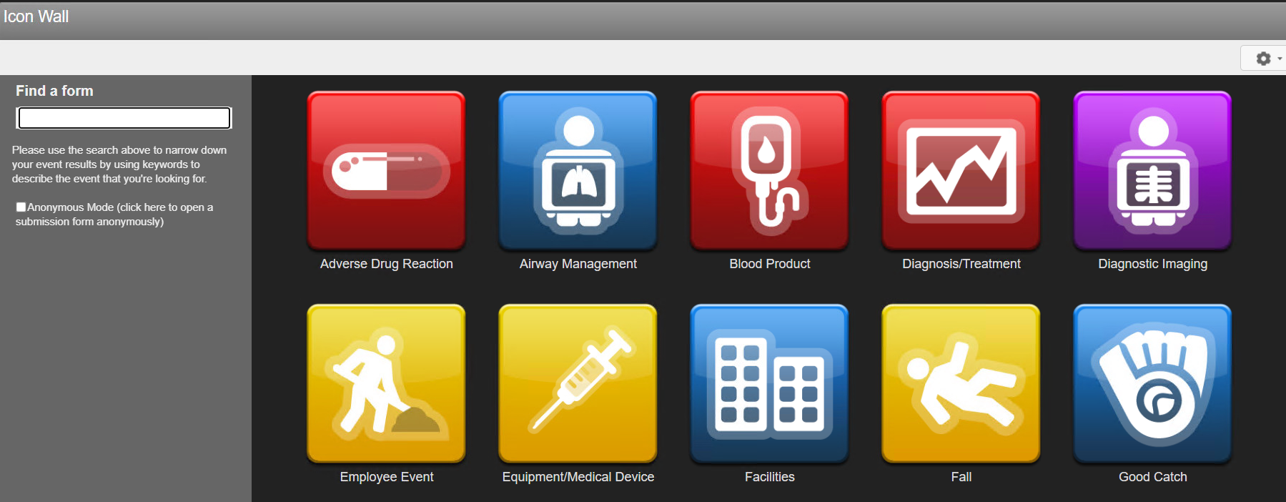
Safety Reporting System
Also known as Safety Tracking And Reporting System (STARS)
Required by Federal/State Law
Confidential/Non-punitive
Enables prompt review and response
Allows for data collection/trending
New Employee Orientation
24

Slide 25
Patient Safety- “Don’t Hesitate”
BID-Milton staff are expected to “speak up” and report risk/safety events without fear of repercussion, retribution or disciplinary action
Major events may require immediate action
Duplicate reports are NOT a problem, do not assume something has already been reported.
Less serious events may become significant when they occur and are reported frequently.
Feel comfortable to discuss with your manager any follow up to a report that you may have submitted.
Internal Resource: Health Care Quality Department
External Reporting: The Joint Commission, Department of Public Health, Board of Registration in Medicine.
New Employee Orientation
25

Slide 26
Department of Healthcare Quality and Patient Safety
Provide oversight of STARS.
  Ensure the proper Managers, Directors, or Chiefs are reviewing and addressing the reported issues.
Tracks and trends multiple quality of care metrics and externally reports these metrics as required.
Help coordinate communication across departments when addressing an issue (Performance Improvement)
Organize responses to unexpected or adverse events
Aid in the development of policies and procedures.
Oversee Hospital wide Infection Prevention and Medical Staff Credentialing
New Employee Orientation
26

Slide 27

Speak Up for Safety: “I’m Concerned”
New Employee Orientation
27

Slide 28
"The names of the patients whose lives we save can never be known. Our contribution will be what did not happen to them. And, though they are unknown, we will know that mothers and fathers are at graduations and weddings they would have missed, and that grandchildren will know grandparents they might never have known, and holidays will be taken, and work completed, and books read, and symphonies heard, and gardens tended that, without our work, would never have been."
Donald M. Berwick, MD, MPP, President Emeritus, Institute for Healthcare Improvement

Slide 29
Contact Information
Department, Healthcare Quality & Patient Safety
  Elizabeth Moseley, RN, MSN
  Manager, Patient Safety
  Extension 1059
  Elizabeth_Moseley@bidmilton.org
New Employee Orientation
29

Slide 30
Infection Prevention
New Employee Orientation
30

Slide 31
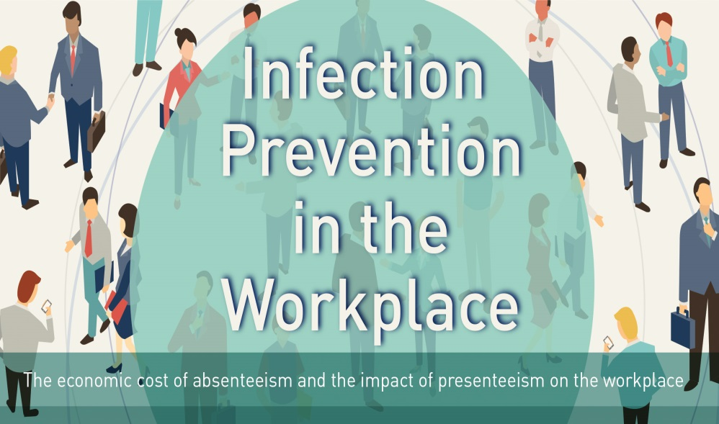
Goals of Infection Prevention
Stop the spread of infection at BID-Milton Hospital
Reduce risk for exposure/ transmission of infection to our patients, visitors and care providers
New Employee Orientation
31

Slide 32


Healthcare Associated Infections (HAIs)
STATISTICS
# HAIs/Year in US Hospitals | 1.7 Million
# Rate of HAIs | 1: 7.5 Patients
# Patients who Die/Year in US from HAIs | 100,000
Cost to Treat each HAI | $11,000-$45,000
Total Cost of HAIs in US/Year | $ 45 Billion
New Employee Orientation
32

Slide 33


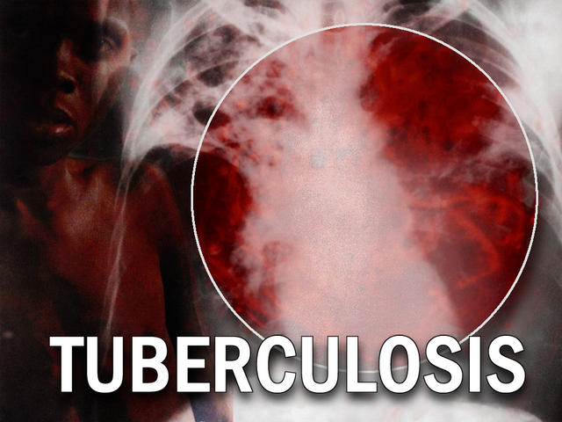

How is Infection Transmitted?
CONTACT | DROPLET | AIRBORNE
Direct: Person to Person from Physical Contact Indirect: Contact with a Contaminated Object | Passed in the air and is inhaled (Coughing/ Sneezing) | Suspended in the air for long periods and can be carried long distances
New Employee Orientation
33

Slide 34

Hand Hygiene
The single most effective measure to prevent the spread of infection
When ? (5 Moments of Hand Hygiene) | How ?
Before touching patient Before clean/aseptic procedure After body fluid exposure After touching a patient After touching patient surroundings | Soap and water when hands visibly soiled or C-Diff Under running water for at least 20 seconds Dry hands and use paper towel to turn off faucet Alcohol foam dispensers “Didya?” Nail management policy
New Employee Orientation
34

Slide 35
How is Transmission of
Infection Prevented?
Standard Precautions
  Consider all patients/visitors/co-workers as potentially infectious
  Correct use of Personal Protective Equipment (PPE)
  Safe handling and disposition of soiled linen or waste
  Proper disinfection practices –
    Cleaning patient care equipment
    Cleaning surfaces
COVID changes
  EVERYONE in the hospital must be wearing a procedure mask
  Staff in patient care areas must also be wearing a face shield
New Employee Orientation
35

Slide 36
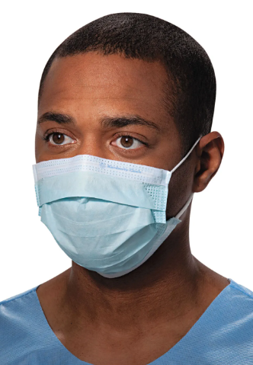

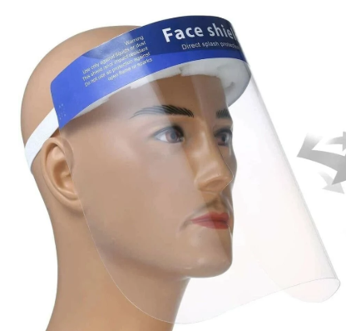
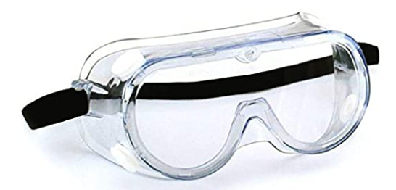
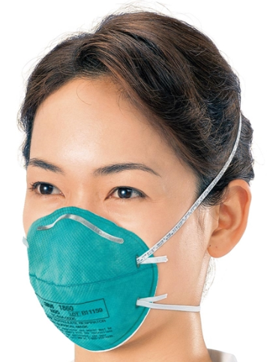
How is Transmission of
Infection Prevented?
Isolation Precautions and PPE:
  Contact/Contact Plus
    Gloves
    Gowns
  Droplet/Droplet Plus
    Procedure masks
    Goggles
    Face Shields
  Airborne
    N95 masks
New Employee Orientation
36

Slide 37
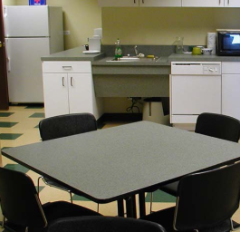
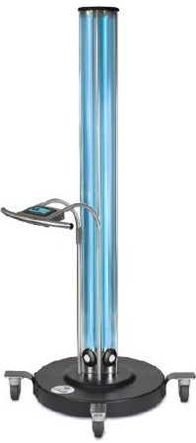
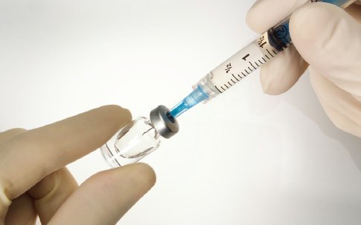
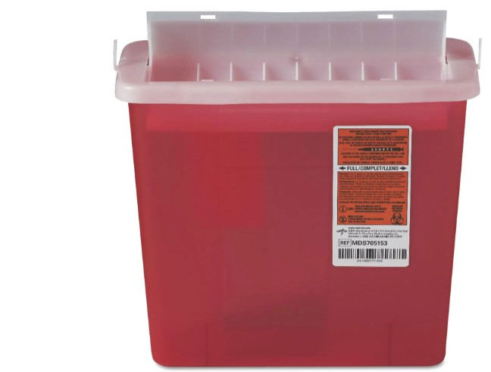

How is Transmission of
Infection Prevented? cont’d
Designated staff eating areas
EVS cleaning practices: Inc. UVC light technology
Employee vaccination
Safe sharp use and disposal (Inc. Safety Devices)
Cough etiquette
New Employee Orientation
37

Slide 38

Infection Prevention:
Break the Chain
http://www.bing.com/videos/search?q=infection+prevention+video&&view=detail&mid=5F87AD1C94005D6927725F87AD1C94005D692772&rvsmid=5F87AD1C94005D6927725F87AD1C94005D692772&fsscr=0&FORM=VDFSRV
New Employee Orientation
38

Slide 39
Human Resources
Supporting the Employee Experience
New Employee Orientation
39

Slide 40

The Employee Experience
It’s our effort to convey to you that each of you are the key to an exceptional patient experience
It’s what you encounter, observe and feel
New Employee Orientation
40

Slide 41


The Employee Experience
WE CARE Surveys
At 30 days - 22 questions plus open response
At 90 days -26 questions plus open response
Average time to complete = <5 minutes
Invitations come from Glint (survey@mail.us1.glintinc.com)
New Employee Orientation
41

Slide 42
Human Resources Team
Human Resources is here to support you throughout your career
A resource for guidance, information and questions regarding policy, procedures, benefits, and employee relations.
Contacting HR: 617-313-1106
  Press 1 for Employee Benefits
  Press 2 for Leave of Absence/Disability
  Press 3 for Employment Verification
  Press 4 for Employee Health
  Press 5 for All Other HR Questions – will enable you to connect with an HR Service Center professional
  Press 6 for Kathy Manning, BID-M HR Coordinator
New Employee Orientation
42

Slide 43
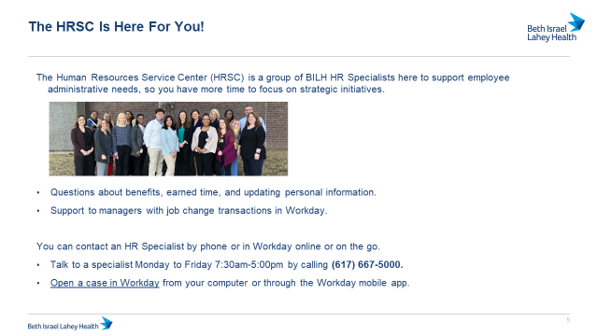
Contacting Human Resources
New Employee Orientation
43

Slide 44


Supporting Your Experience: Intranet/BID-Milton Portal
Click on one of these icons.
New Employee Orientation
44

Slide 45
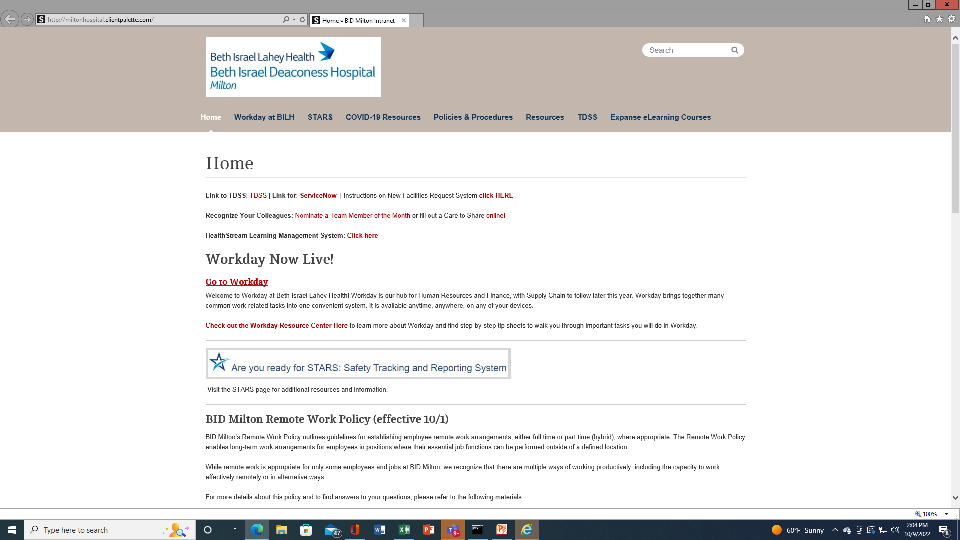
Supporting Your Experience: Intranet/BID-Milton Portal
New Employee Orientation
45

Slide 46
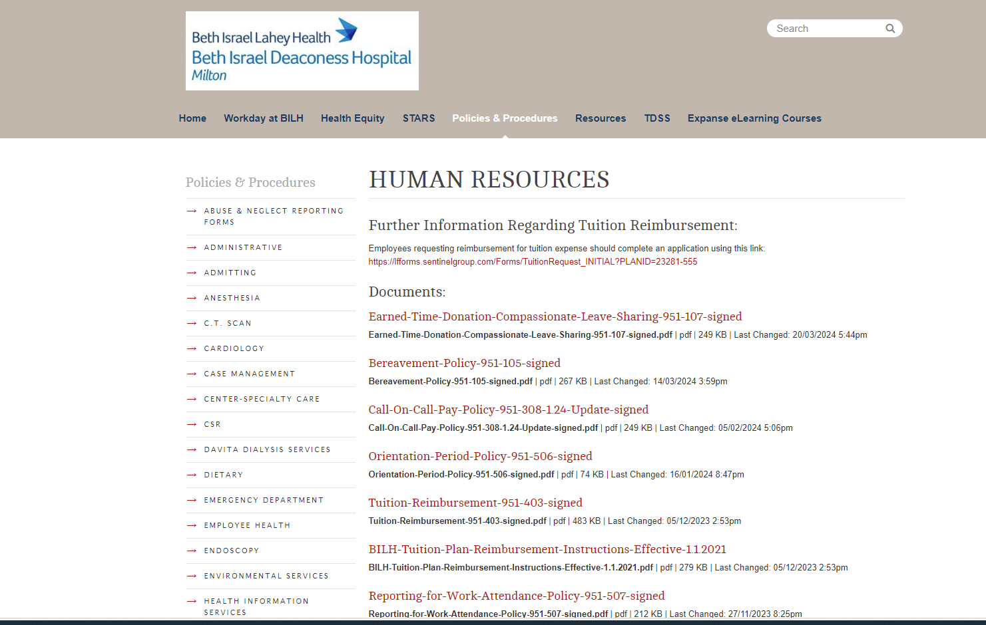
Supporting Your Experience: Intranet/BID-Milton Portal
New Employee Orientation
46

Slide 47

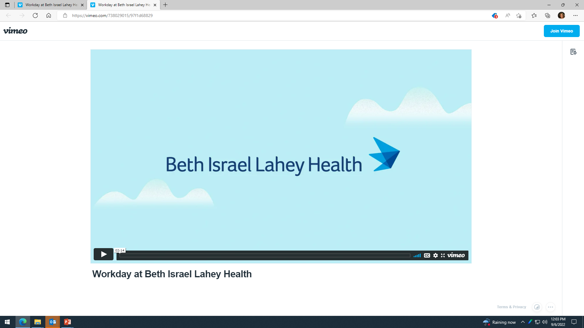
Supporting Your Experience:
WORKday
Getting Started in Workday video
New Employee Orientation
47

Slide 48
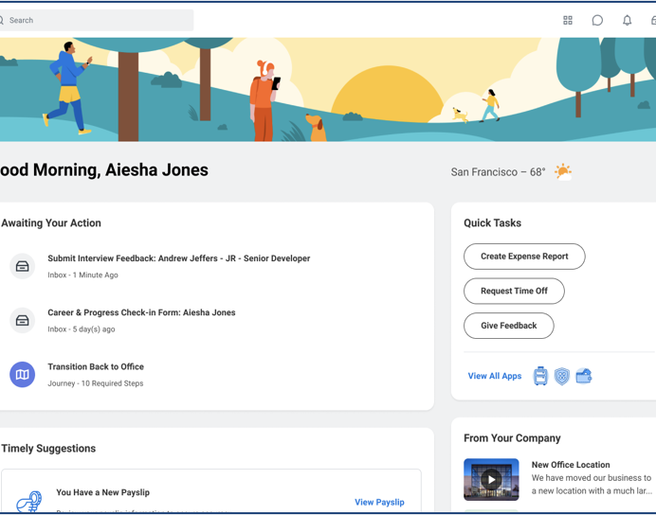
New Hire Journey in Workday

Slide 49
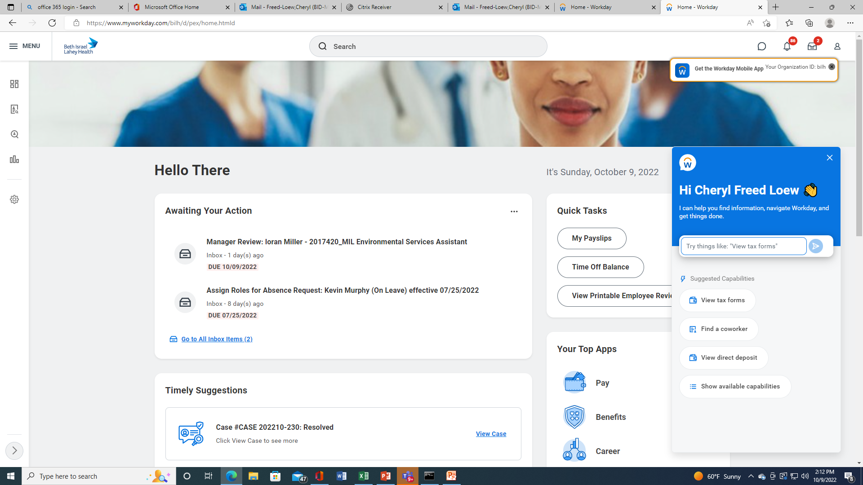
Supporting Your Experience:
WORKday
You Need your system log in to get started.
New Employee Orientation
49

Slide 50

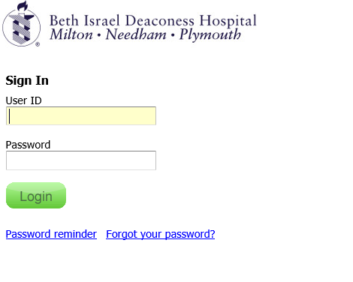
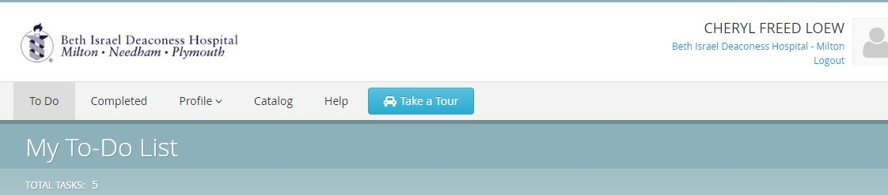
Supporting Your Experience: HealthStream
(Computer Based Leaning)
Access via this icon or via the Intranet.
You will be taken to the HealthStream log in page which includes first time log in instructions. (Refer to handout in your packet)
New Employee Orientation
50

Slide 51





Supporting Your Experience:
E-Mail
To check/use email only, click on this icon.
For access to the full Office Dashboard click here.
For access email from outside the hospital, use these links.
https://outlook.office365.com/owa/
http://www.office.com/signin
You will need this application; MDM: Mobile Device Manager
Check e-mail regularly for important information/updates.
New Employee Orientation
51

Slide 52
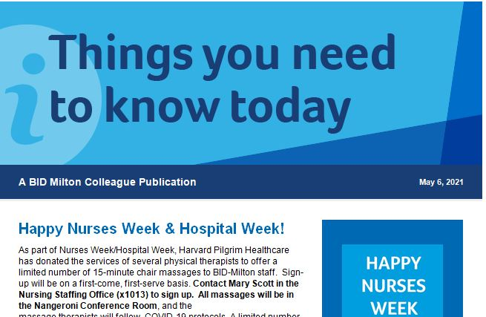
Supporting Your Experience:
The Bulletin Boards (across from the cafeteria) Notices are posted regarding:
    Special events
    Federal and State required postings
BID-Milton Communications
New Employee Orientation
52

Slide 53



Recognition Programs
Patients, Staff and Visitors may recognize any staff member.
Recipient receives $5.00 coupon redeemable cafeteria.
Nomination forms available throughout the hospital or on line.
New Employee Orientation
53

Slide 54
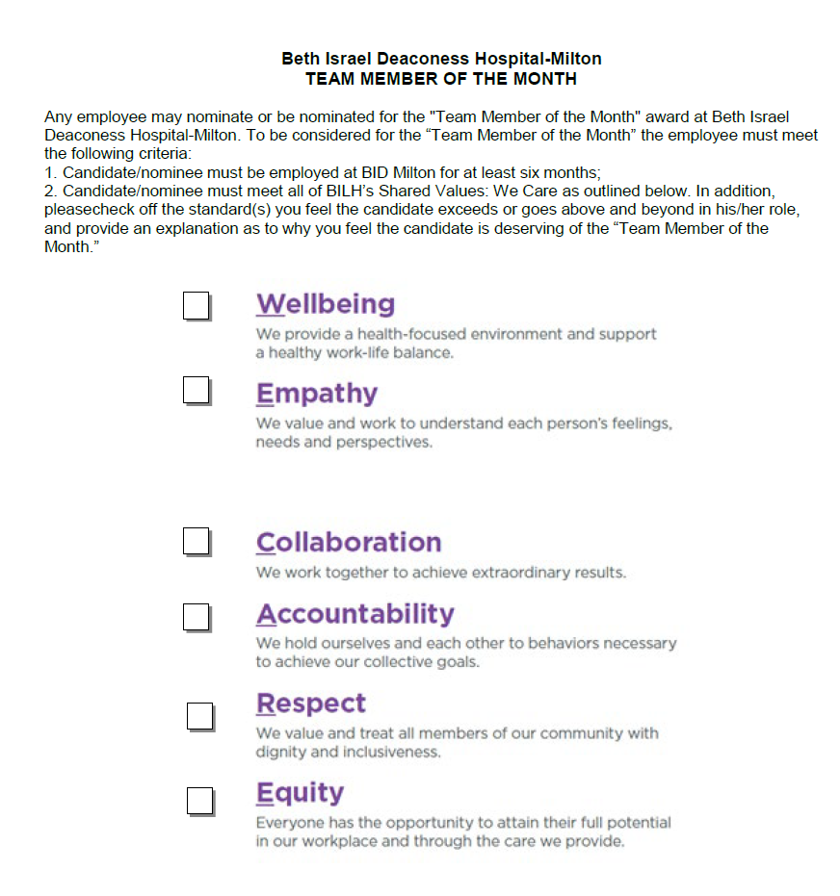
Recognition Programs
Team Member of the Month
Anyone can nominate.
Nomination forms available on the Intranet
New Employee Orientation
54

Slide 55
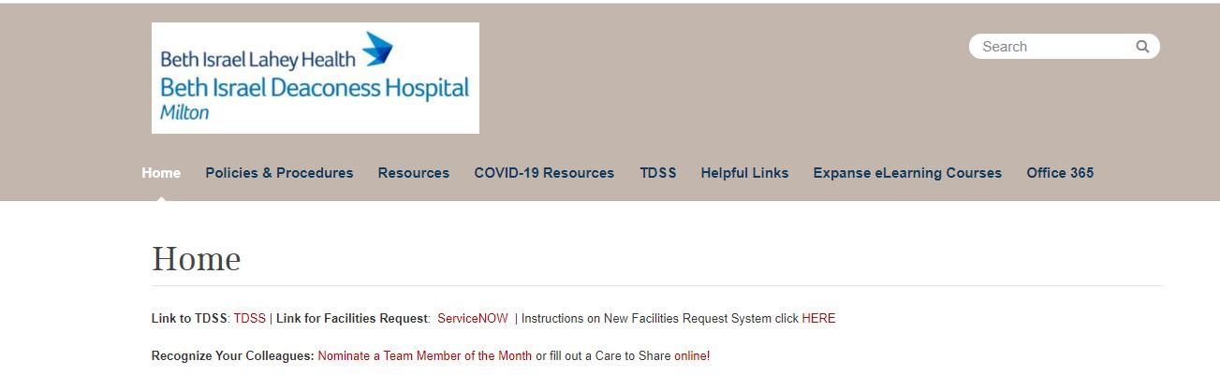
Recognition Programs
When you go to this intranet page just click on the appropriate nomination form.
New Employee Orientation
55

Slide 56
Human Resources:
Pay
Your manager will provide you with instructions on how to record your time, meal breaks and department specific guidelines.
Pay periods are two-week periods beginning Sunday at 7:00am.
Pay day is every-other Thursday.
Please sign up for direct deposit ASAP; it may take a few pay periods to process. Paychecks are mailed to those staff members who do not have direct deposit.
  Sign-up via Work Day, “Payment Elections”.
New Employee Orientation
56

Slide 57
Human Resources:
Benefits Eligibility
Employment Status | Hours Worked/ Per Pay Period | Benefits Eligibility
Regular Full Time (RFT) | 80 hours | Eligible for all benefits
Special Part Time (SPT) | 72 hours (3 12 hour shifts per week) | Eligible for all benefits
Part Time (PT) | 40+ hours 32-40 hours | Medical, Dental, Vision, FSA plans, some Voluntary plans, and pro-rated ET/EIB Some voluntary benefits and pro-rated ET and EIB
Per Diem (CALL) and Part Time (less than 32 hrs.) | Schedule varies | Accrue MA Earned Sick Time (MEST)
Presentation title here | Month 2019
57

Slide 58
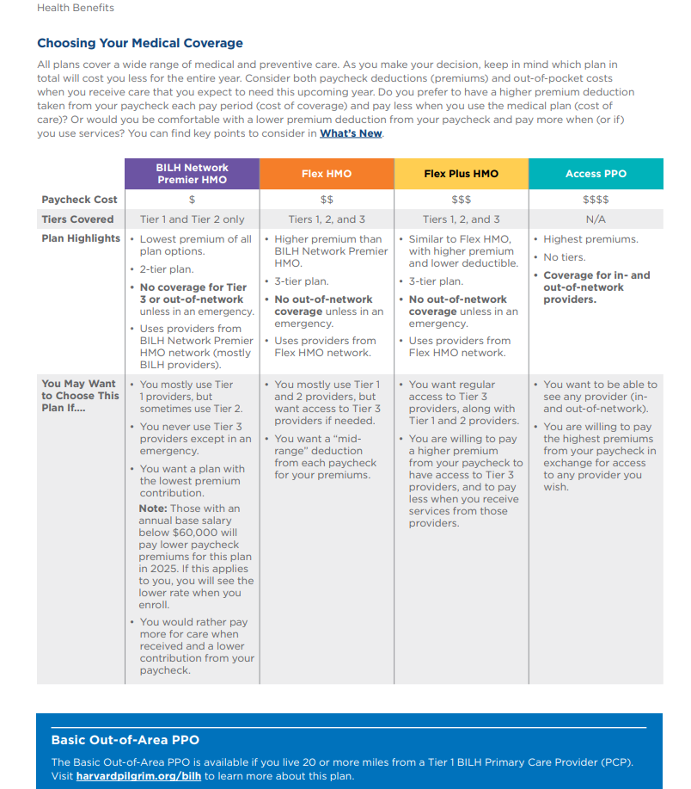
Human Resources:
Summary of Benefits
New Employee Orientation
58

Slide 59
Human Resources:
Welcome to your BILH Benefits
Look for your Benefits Welcome email!
Once you have accessed your BILH email account, look for an email from BILH Benefits titled “New Employee Benefits Information & Instructions.” This email will include important information including:
The BILH New Hire Benefits Guide with a detailed overview of your benefit options
Instructions to join the live virtual benefits orientation (through 1/17/25)
Instructions to help you enroll in benefits online through Workday
Where to go for help and support with your benefits enrollment
How to Contact Benefits
Call the HR Benefits Helpline at 617-667-5000
Submit a Help Case through Workday, our online payroll and benefits system
New Employee Orientation
59

Slide 60
Human Resources:
Signing Up for Benefits
Benefits are effective on your 1st day of employment
You have 30 days from your first day of employment to enroll in benefits via Workday*
When else can I make benefit changes?
Outside of your 30-day new hire enrollment window, you may only submit changes to your benefits if:
You have an internal job change which impacts your benefits eligibility
During Annual Open Enrollment, which occurs every Fall for benefits effective in January of the following year
If you have a Qualifying Life Event such as a marriage, divorce, birth/adoption of a child, or a gain or loss of benefits coverage on another plan
*Refer to Handout: “How to Elect Benefits in Workday”
New Employee Orientation
60

Slide 61
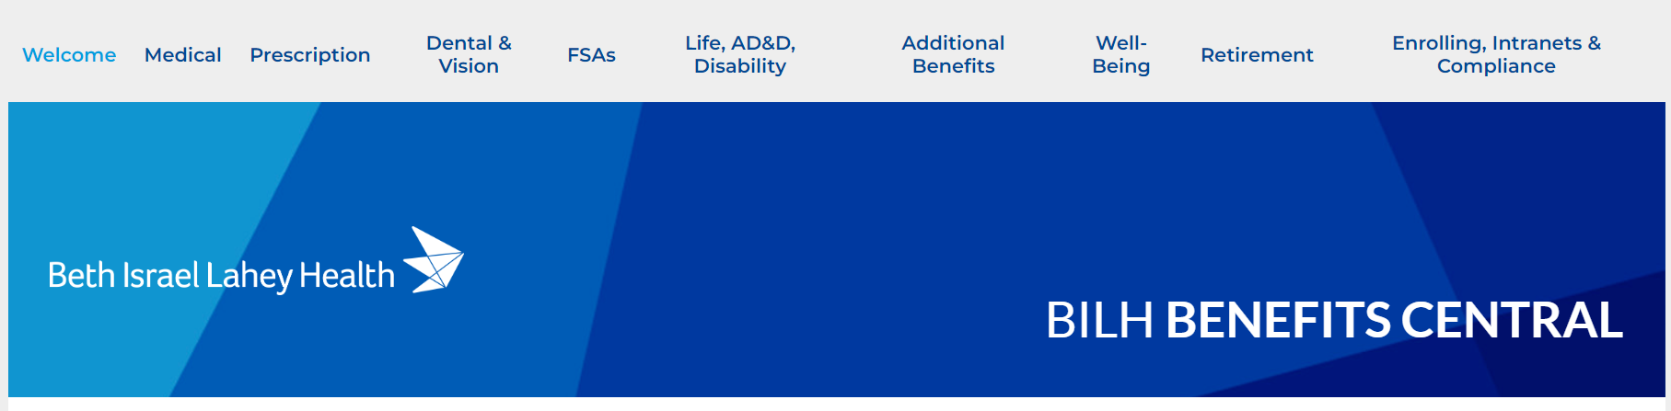
Human Resources:
Learn About Your Benefits
Attend a Bi-Weekly Virtual Benefits Session (ends 1/17/25)!
Every 1st and 3rd Friday of the month from 12pm-1:30pm, the benefits department hosts a virtual benefits orientation where you can learn about your benefits and get your questions answered by a benefits representative. A link and call-in options to the virtual session is included in your benefits welcome email.
You are welcome to join any Friday session within your first 30 days!
https://zoom.us/j/91747099425#success
Visit BILH Benefits Central
Visit flimp.live/BILH-benefits to browse through your BILH benefit plan details, review plan summaries, view enrollment instructions, and more!
New Employee Orientation
61

Slide 62
Paid Time Off Program
32 hours or more per pay period
Less than 32 hours per pay period
MA Earned Sick Time (MEST)
Earned Time (ET)
Extended Illness Bank (EIB)
Accrual starts at date of hire.
  Eligibility for use of ET/EIB after completion of three months of employment. Per Diem staff have use of 40 hours of MA Earned Sick Time from day one. Remember though, this is 40 hours to use per calendar year.
New Employee Orientation
62

Slide 63
Paid Time Off Program
  Earned Time (ET)
Accrual rate based on your position, employment type, and length of service: (FT: between 216-272 hours per year, PT: between 128-190 hrs per year).
Use for: vacation, sick, personal, holidays and reasons designated by MA EST law.
  Extended Illness Bank (EI)
  Use as “Insurance Policy” for income protection due to personal illness/injury. Eligible for use following first 3 days of an illness. (Unused balance not paid at loss of benefit status or end of employment).
  Full time accrual rate allows up to 72 hours per year (Part Time accrual is prorated).
New Employee Orientation
63

Slide 64
Paid Time Off Program
  MA Earned Sick Time (MEST) – is a plan for the accrual of time for employees who are in positions less than 32 hours per pay period.
  Employees will receive the annual maximum accrual of 40 hours in a lump sum on an annual basis.
Paid for time off reasons designated by the MA Earned Sick Time Law. Allows employee to take time off without penalty and to accrue paid time off for use due to specific permissible reasons identified in the law.
Refer to S.O.P. # 951-110 for details.
New Employee Orientation
64

Slide 65
MA Paid Family Leave
Massachusetts passed the Paid Family and Medical Leave (PFML) law in 2021 for the benefit of Massachusetts employees.
Employees may be eligible for the following types of leave below under the PFML law. Such leave cannot exceed a combined total of 26 weeks in a benefit year.
Paid leave up to:
12 weeks in a benefit year for the birth, adoption, or foster care placement of a child
12 weeks in a benefit year for certain reasons arising out of a family member on active duty or being notified of a call to active duty in the Armed Forces
20 weeks in a benefit year for the employee’s own serious health condition
26 weeks in a benefit year to care for a family member who is a covered service member undergoing medical treatment or otherwise addressing consequences of a serious health condition relating to the family member’s military service
12 weeks in a benefit year to care for a family member with a serious health condition
New Employee Orientation
65

Slide 66

Retirement Benefits
All employees are eligible to contribute to a 403b tax deferred retirement savings account.
Hospital 3% core contribution after:
  1 year employment and 1000 hours paid
The plan is administered by Fidelity Investments.
Numerous investment options are offered.
Rollovers from other 403b plans allowed.
To enroll:
  1-800-343-0860. Plan # 65402
New Employee Orientation
66

Slide 67

Other Benefits
Tuition Assistance - Available after six months of employment
(available for staff working at least 32 hours per pay period)
Talent Development Opportunities
Short Term and Long Term Disability Insurance- Available after six months
Life and Accidental Death & Dismemberment Insurance
Supplemental Life Insurance
Critical Illness Insurance
Hospital Indemnity Insurance
Legal Insurance
Benefits and Discounts Through BenefitHub
(bilhperks.benefithub.com, Referral Code = BE1UCI)
Care.com: Expert Assistance finding care for family and pets
(855-781-1303 or expertassitance@care.com)
BID-Milton Cafeteria Discount: 15% on all items
New Employee Orientation
67

Slide 68

Career Development
Supporting all employees in growing their careers with us
All BILH employees have access to:
1:1 Career and Academic Advising
Rigorous ESOL courses through JVS
Free Community College Courses through Bunker Hill and North Shore Community Colleges
Career Development Workshops
Financial Fitness Workshops
Discounted Bentley MBA program
For more information contact:
careerdevelopment@bilh.org
New Employee Orientation
68
Notes:
Confidential access to resources for counseling, financial consultation, emotional well-being, family and legal resources and referrals.
Licensed professionals available 24 hours a day, 7 days a week .

Slide 69
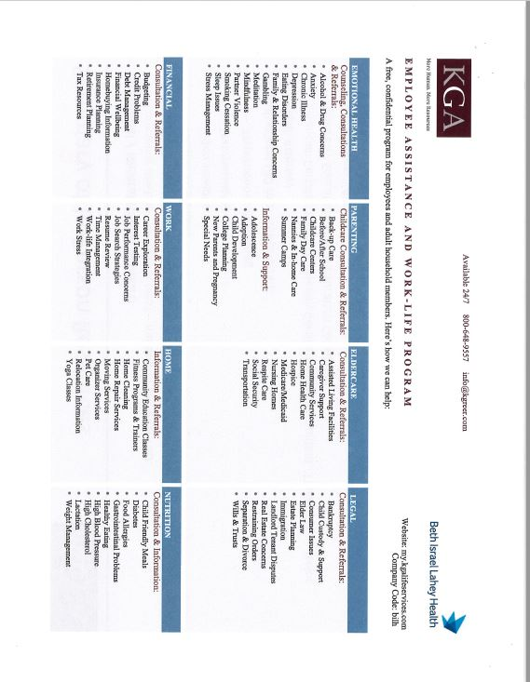
Other Benefits
Employee Assistance Program
New Employee Orientation
69
Notes:
Confidential access to resources for counseling, financial consultation, emotional well-being, family and legal resources and referrals.
Licensed professionals available 24 hours a day, 7 days a week .

Slide 70

Human Resources:
Supporting The Employee Experience
  We are here to support you throughout your BID- Milton Career – a resource for guidance, information and questions regarding policy, procedures, benefits, and employee relations
Remember: review your benefit options –
make elections within the 30 days from your
hire date and sign up for direct deposit a.s.a.p!
Thank you and Welcome to BID-Milton!
New Employee Orientation
70

Slide 71
Preventing Injuries on the Job
(Employee Health)
New Employee Orientation
71

Slide 72
Learning Objectives
Preventing Injury on the Job
Upon completion of this module you should be able to:
Select the appropriate lifting equipment.
Use safe lifting techniques.
Know when to ask for help when lifting.
Practice wheelchair safety.
72

Slide 73

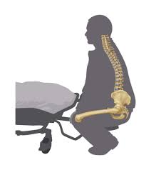
Preventing Injury on the Job
Did You Know?
Back injuries are seldom caused by a single
incident!
Decrease your risk of injury now and in the future
EVERY TIME:
Use The Right Equipment
As well as Good Body Mechanics
.
73

Slide 74
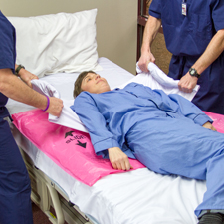
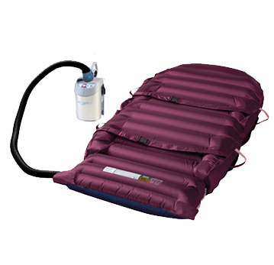
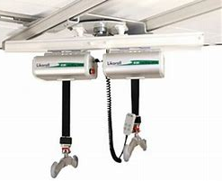
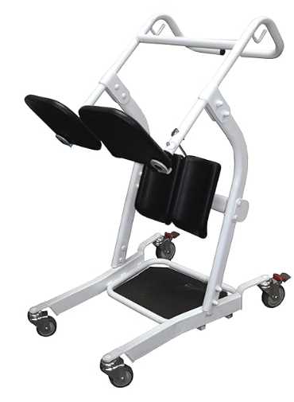

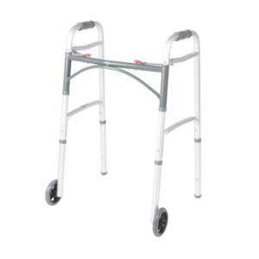


Preventing Injury on the Job
Choosing the Right Equipment for Every Transfer
Transfer
Options Available @ BID Milton*
Pink Slip
Provolan mat
Ceiling lift
Slide Transfer /
Boost
Patient’s usual equipment
Lumex
Ceiling lift
Tenor Lift
Out of Bed
*If you have any questions about how to use equipment please speak with your supervisor, an experienced co-worker or a Rehab Staff member
74

Slide 75
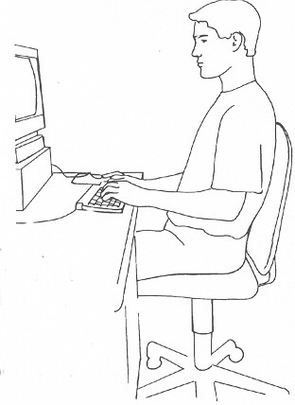
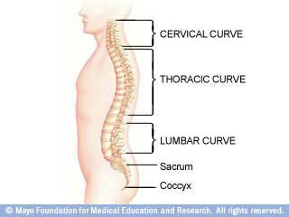
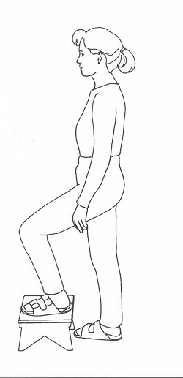
Preventing Injury on the Job
Good Posture
Good Posture means the natural curves of the spine are not strained but are in a neutral position ready to absorb and distribute loads.
When Sitting:
Feet flat with knees at hip level.
Lumbar support or chair armrests to support weight of our arms.
Sit close to your work area.
When Standing for Prolonged Times:
Place one foot in front of the other or on a stool.
Stand on a cushioned or rubber mat.
.
75

Slide 76
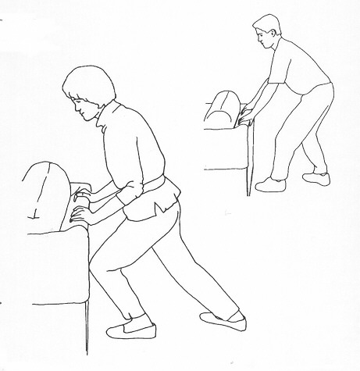
Pushing is Better Than Pulling
Preventing Injury on the Job
You can push TWICE as much as you can pull
Pushing allows you to:
Keep upright
Use your body weight to create momentum
See where you are going!
.
76

Slide 77
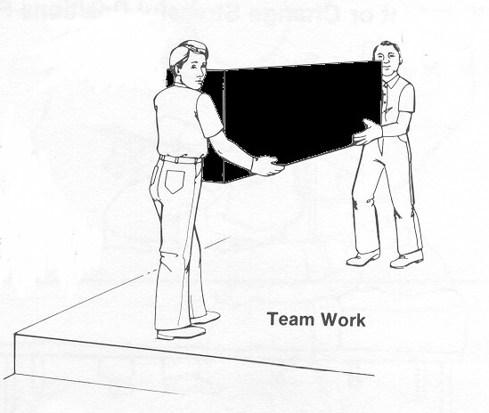
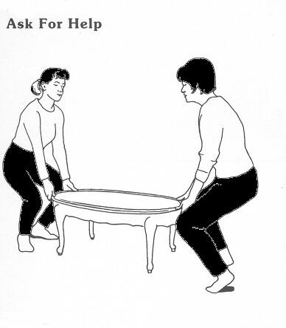
Preventing Injury on the Job
When Should You Ask for Help?
Anytime an object weighs 35 pounds or more, you may need to use lifting equipment and/or get a SECOND person to assist you to ensure safety.
.
With Patient Care, consider how much the patient is able to follow commands and assist when determining the need for a Second Assist.
77

Slide 78

Preventing Injury on the Job
Safe Lifting Mechanics
Keep your head and chest up and maintain your low back curve.
Position your feet shoulder width apart.
Bend at the hip and knee.
Keep objects (weight) close to the body and directly in front of you.
Use your legs to lift.
Step when moving the object, DO NOT keep your feet planted and twist your back.
.
78

Slide 79
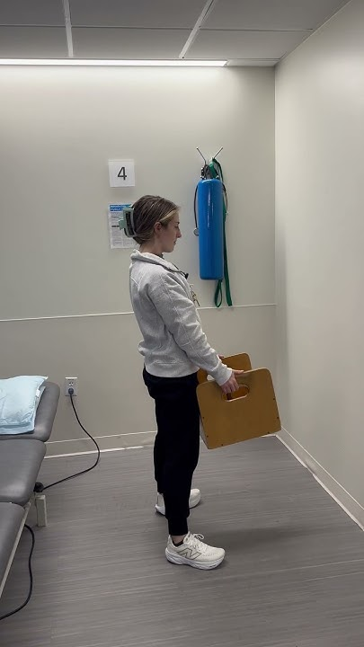
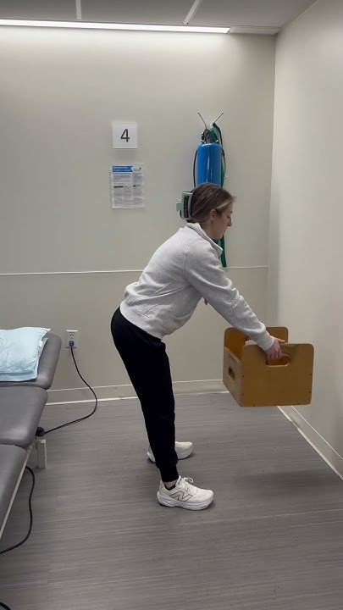
Preventing Injury on the Job
Safe Lifting Mechanics
Squatting (correct way to lift)
Stooping (wrong way to lift)
79

Slide 80
If you are injured
Steps to Take
Use Caution to avoid further injury.
Let your supervisor know immediately
Complete STARS report before end of shift
See Employee Health / ED
Use ice
Balance Movement and rest
80

Slide 81
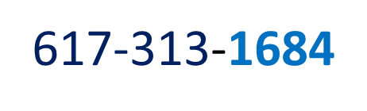
Employee Health Services
Steps to Take
Pre-Employment Clearance
Return to Work Clearance
Vaccination, Fit Testing, Other Programs / Services
81

Slide 82
Mandated Reporting
New Employee Orientation
82

Slide 83

Mandated Reporting
Definitions
Abuse: A non-accidental action or inaction taken by an intimate partner, family/household member or caregiver which causes physical or emotional injury
Neglect: The failure of a caregiver to provide essential care, supervision, or protection to a dependent person, resulting in harm or risk of harm
Abuse impacts people of all races, ethnicities, gender and sexual identities, religions, abilities, and socio-economic classes.
New Employee Orientation | 2025

Slide 84

Mandated Reporting
Intimate Partner Violence
Intimate Partner Violence (IPV) is a pattern of behavior used to establish non-consensual power and control over another person through fear and intimidation
  Abuse may be emotional, verbal, financial, technological and cultural, and may or may not include physical and sexual
.
Healthcare professionals may be the first to recognize signs, symptoms, or to receive disclosures of abuse or neglect
New Employee Orientation | 2025

Slide 85

Mandated Reporting
Forms of Abuse
​Emotional Abuse:
Continued Attacks on Self Esteem
Insults
Repeated Harassing or Interrogating
Forcing to Stay Awake,
Blaming for All that Goes Wrong, Isolation, Mind Games, Controlling Access to Support Network, Accusations of Cheating or "Mutual Abuse"
Financial Abuse:
Refusing Partner Access to Money for Basic Needs
Preventing Partner from Getting a Job or Keeping a Job
Controlling All Assets
Putting all Bills in the Partner's Name
Running up Charges
Ruining Credit
Physical Abuse:
Slapping/Punching
Kicking
Biting
Spitting
Pinching
Pushing
Use of Weapons
Throwing Objects
Strangulation
Denial of Physical Needs:
  Sleep, Food, or Medical Attention
Verbal Abuse:
Threats to hurt/kill partner, children, pets, self
Yelling/Screaming
Threats to take Children
Threats to Disclose Information about Partner that is Confidential (such as past abuse)
Name Calling
Threats to Use Partner's Immigration Status, Disability or Sexual Identity Against Them
Sexual Abuse:
Manipulation/Blackmail
Guilt-tripping
Coercing
Forcing Degrading Sexual Acts
Jokes/Insults/Comments like “Whore” or “Slut”
Unwanted Touching or Groping
Birth Control Refusal
Exposing self
New Employee Orientation | 2025

Slide 86

Mandated Reporting
Who Is Mandated to Report?
Anyone can report suspected abuse or neglect, but a Mandated Reporter is a person who is required by state law to make a report
    Only need a "mere suspicion" or "reasonable cause to believe"
The hospital is required by state law to report concerns of abuse/neglect
DID YOU KNOW?
A reporter's name and reasons for reporting is kept confidential
There can be a fine or penalty for a mandated reporter chooses not to report
Mandated Reporters include any hospital personnel who are engaged in the examination, care or treatment of individuals
New Employee Orientation | 2025

Slide 87

Mandated Reporting
Who to Notify
Children – under age 18
Department of Children and Families (DCF)
Hotline: 800-792-5200
Disabled Persons – ages 18 – 59
  Disabled Persons Protection Commission (DPPC)
  Hotline: 800-426-9009
Older Adults – age 60 and living home
  Adult Protective Services (APS)
  Hotline: 800-922-2275
Institutional Abuse
Abuse of a resident of a skilled nursing facility, rest home or other healthcare facility or organization licensed by the Department of Health gets filed directly with DPH
New Employee Orientation | 2025

Slide 88


Mandated Reporting
Call Our Team
Notify your manager/supervisor
  Consult with Social Work and/or file your report of concern with the appropriate agency
A referral to Social Work is made
  7 days a week, 8am-4pm
  During off hours, the Nursing Supervisor can be reached to assist
Melissa Drohan, LICSW
Ext 1127
  Melissa_Drohan@bidmilton.org
Kellie Murphy, LCSW
Ext 1473
  Kellie_Murphy@bidmilton.org
  Marly Nazaire, LCSW
  Marly_Nazaire@bidmilton.org
New Employee Orientation | 2025

Slide 89
Integrity and Compliance
New Employee Orientation
89

Slide 90
Topics Covered
Code of Conduct-Key Points
Key Rules and Regulations:
  HIPAA Privacy and Security
  Sensitive Information
  State Data Laws
  Fraud, Waste and Abuse
  False Claims Act, Stark Law, and Anti-Kickback
Gifts & Conflicts of Interest
Reporting Concerns
        When to Speak Up
        Non-Retaliation
Contact Information

Slide 91
Code of Conduct Overview
Compliance is everyone's responsibility at
BID-Milton
The Code of Conduct applies to each and every one of us and serves as our guide for navigating common issues, whether you work in clinical care, research, education or an administrative role.
While the Code of Conduct does not cover every issue we might encounter, it provides a framework for approaching many common situations and works in conjunction with human resources, clinical, and other policies
The Code of Conduct also includes resources for questions you may have and important information about how to report concerns, including anonymously
Please make sure to read the Code and familiarize yourself with the important topics covered. Should you have any questions or concerns, please reach out to your supervisor or Integrity and Compliance

Slide 92
Key Rules and Regulations
The Health Insurance Portability and Accountability Act of 1996 (HIPAA)
What is it?
Federal law that requires the creation of national standards to protect sensitive patient health information from being disclosed without the patient's consent or knowledge.
HIPAA allows physicians, nurses, technicians and other workforce members to access, use or disclose patient information for the purposes of treatment, payment or operations (TPO)
Examples:
Treatment: inpatient and ambulatory medical care and services
Payment: billing and receipt of payment for services provided
Operations: activities, such as looking at procedure data or doing quality audits, necessary to run the organization and ensure all patients are receiving high quality care

Slide 93
Key Rules and Regulations, cont’d.
HIPAA: What is Protected Health Information (PHI)?
PHI is any information that relates to the past, present, or future health of an individual which identifies or could be used to identify the individual. PHI includes (but is not limited to):
Electronic PHI (ePHI) is PHI that is found on electronic media devices. This includes but is not limited to:
name
Date of service
email
Phone #
Medical/clinical information
photos
Medical record #
Any other identifying code, number, picture, etc.
Desktop computers, laptops, tablets, smartphones and other mobile devices
Memory sticks (USB, thumb drives)
Email or websites
Computer network

Slide 94
Key Rules and Regulations, cont’d.
HIPAA: Minimum Necessary
Under HIPAA’s minimum necessary provisions, a health care provider must make reasonable efforts to limit PHI to the minimum necessary to accomplish the purpose of the use, disclosure or request.
Before accessing information, ask yourself “do I NEED this information to do my job?”.
If the answer is “no”, do not access the information.
Remember, if you can accomplish the goal without PHI, then don’t use PHI!

Slide 95

Key Rules and Regulations, cont’d.
HIPAA: DO’s and Don'ts
DO
Close exam room doors when caring for patients or discussing their health concerns
Tell your supervisor / compliance if you see patient information in an open trash container
Turn computer screens so patients and other individuals can’t see information on the screen
Double-check e-mail addresses and fax numbers before securely sending patient information
Request 2 identifiers (name & DOB) to verify a patient’s identity before disclosing PHI
Dispose of all paper with patient information using the shredder bins provided
Correctly register patients and process billing information
Use low voices and discretion when discussing patient protected health information (PHI)
Double check all sheets of paper before mailing or handing to a patient
Report ALL privacy concerns to your supervisor or privacy officer including lost or stolen PHI

Slide 96
Key Rules and Regulations, cont’d
HIPAA: Do’s and Don'ts
DON’T
Share patient information with family, friends, news reporters, etc. without prior approval from the patient
Talk about patients in public places, such as elevators, hallways or cafeteria lines
Allow faxes or printed e-mails containing PHI to lie around the office
Leave a medical record open while you leave the room to care for another patient
Keep materials that connect patients’ names with their conditions out in the open where anyone can see them
Leave phone messages containing sensitive patient information on answering machines or voicemail systems
Go into patient medical records unless you have a clinical or business need to do so

Slide 97

Keep in Mind: Sensitive Information
In addition to HIPAA, there are state and federal rules that give greater protection to certain sensitive information. This information may require even more protections and specific authorization to release for our patients. This includes information such as:
        Alcohol or Drug Use Treatment*
        Sexually Transmitted Diseases
        Domestic Violence Victim's Counseling
        Communication between a patient and Social Worker
        Psychiatric Health - Mental Health Information
In Massachusetts, HIV/AIDS Diagnosis and/or Treatment and Genetics Testing are subject to heightened protections
When dealing with sensitive information, PAUSE and triple check it is appropriate to access, use or disclose. Always follow protocols that are in place for releasing information. Additional authorization may be required. Contact Integrity and Compliance or Legal if you have any questions.
* 42 CFR Part 2, ("Part 2") applies to federally assisted programs and protects the confidentiality of substance use* disorder patient records, including diagnosis, treatment and referral information.

Slide 98
Proper Use of Electronic Health Record (EHR)
We take patient privacy very seriously. It is our duty under the law and forms the foundation for staff and patient trust. Both law and policy require that we use the EHR for work-related purposes only. EHR use is actively monitored for proper access and violations of law or policy will be subject to review and disciplinary action.
Q: My friend asked that I look up their lab results. Can I look up the results?
A: No. EHR use is for work-related purposes only. Even with patient permission, it is against BILH policy. Please use the patient portal or review paper records obtained by the patient for this purpose.
Q: My spouse needs some blood work and I know what he needs done. Can I enter the order?​
A: No, the patient should contact their provider to coordinate testing.
Q: My mother is in the emergency room and I want to confirm her allergy to a medication is documented. Can I add it?​
A: No, you should confirm this information with the patient's care team and only chart in records for patients to whom you are providing care.
Q: I need my child’s immunization records. I can access those, right?
A Even though you may be authorized to direct your child’s care, this access is not work-related. Please use the patient portal or request paper records from HIM for this purpose.
Q: My coworker has been out for a few days and I want to look up their record so I can call them to make sure everything is ok. Can I just access their demographics in the EHR?
A: Demographic information – like name, address, phone number, email address, DOB – is PHI and is protected. This should not be accessed for personal reasons, even with good intentions.

Slide 99
State Data Breach Laws
In addition to HIPAA that protects PHI, many states also have laws that protect Personal Information (“PI”).
    In Massachusetts, PI is defined as a MA resident's first name and last name or first initial and last name in combination with any 1 or more of the following data elements that relate to such resident:
  (a) Social Security number;
  (b) driver's license number or state-issued identification card number; or
  (c) financial account number, or credit or debit card number, with or without any required security code, access code, personal identification number or password, that would permit access to a resident's financial account.
In New Hampshire, PI means an individual's first name or initial and last name in combination with any one or more of the following data elements, when either the name or the data elements are not encrypted:
        (a) Social security number;
        (b) Driver's license number or other government identification number;
        (c) Account number, credit card number, or debit card number, in combination with any required security code, access code, or password that would permit access to an individual's financial account.
There may be breach reporting requirements if PI is obtained by an unauthorized party. If you learned of an incident involving PI, notify your supervisor or Integrity and Compliance (“I&C”) as soon as possible.
Surrounding states may have similar obligations or definitions of PI. Contact I&C with any concerns if PI is impacted by a resident of another state

Slide 100


Fraud Waste and Abuse (FWA)
What is Fraud?
Fraud is the intentional deception or misrepresentation of facts or information that a person knows to be false, which results in an unauthorized benefit to himself/herself or another person.
Fraud
What is Waste?
Waste is defined as the inappropriate, overuse, and
careless spending of funds or resources when there
is not a real need to do so.
Waste
What is Abuse?
Abuse occurs when incidents or clinical/medical practices are not consistent with accepted sound medical or business practices and they create unnecessary costs to government
programs.
Abuse

Slide 101
Examples
Fraud Waste and Abuse (FWA)
Improper billing, up-coding, duplicate billing, billing for items or services not provided or received for free, failing to have proper documentation to support services billed, falsifying documentation of patient care, providing medically unnecessary or substandard care
Fraud
Waste
Duplicate testing, overuse, underuse or ineffective use, prescribing medications for a longer period of time than is necessary, redundancy, delays, and unnecessary process complexities
Billing Medicare and Medicaid patients higher rates than non- Medicare/Medicaid patients, billing Medicare instead of the primary payer, keeping money that doesn’t belong to you, hiring or doing business with someone excluded from the Medicare program
Abuse

Slide 102
Additional Key Laws
Makes it a violation to submit a claim for payment that you know or should know is false or fraudulent; OR Knowingly make, use, or cause to be made or used, a false record or statement material to a false or fraudulent claim (Government does not need to show intent)
False Claims
Act
Prohibits the knowing and willful offer, payment, solicitation, or receipt of anything of value 1) to induce, or in exchange for, the referral of an individual for healthcare services 2) to induce, or in exchange, for the purchase, lease, order, or recommendation for the purchase, lease or order of any health care good, facility, service, or item; or 3) solicitation of anything of value in return for the above.
Anti-Kickback
If a physician (or an immediate family member) has a financial relationship with an entity, the physician may not make a referral to that entity for Medicare designated health services (there are some exceptions)
Stark
If you have questions or concerns regarding these key laws, contact Legal or Integrity & Compliance

Slide 103
Gifts & Interactions with Vendors
Workforce members are not allowed to accept personal gifts for themselves or their staff – including meals – from companies or their employees
This includes any company that:
  • Sells drugs, devices, technology or supplies
  • Provides goods or services
  • Otherwise wants to do business with our organization (including referral sources)
Personal gifts include food, bags, clothing, trinkets, pens and any other item of value.
When you accept, use or display items from a company (including wearing an item or putting it on your desk), it could make a patient or co-worker wonder about your influences and decisions.
Refer to your organizations policy of gifts from patients and any other applicable policies/procedures related to interacting with vendors.
In addition to gifts from patients, there are rules around offering free or discounted goods/services to patients. Before providing anything free or discounted, contact Integrity and Compliance.

Slide 104
Conflicts of Interest
What is a business conflict of interest?
Any situation in which you or a family member have a personal interest (including a financial interest) that may influence, or may reasonably appear to influence, how you carry out your job
Who may be involved?
In addition to yourself, a family member who is a spouse or domestic partner, child, parent, sibling or any person living in the same household
What do I need to do?
Let your manager or leader know if this situation comes up; you may need to formally disclose your interest to the organization

Slide 105



Reporting Concerns: When To Speak Up?
Call Integrity and Compliance immediately if…
A patient voices concerns about a privacy issue
You are not comfortable with action that you think may not be in the best interest of our patients.
You think an Workforce member or vendor is doing something unethical, illegal or improper.
You disagree with how a provider is billing for services.
Ex. Patient receives another
patient’s
medical information in the mail
Ex. Patients referred only to a clinic that a providers family member owns
Ex.
Stealing (work time, hospital resources, patient property)
Ex. Billing for care not provided

Slide 106
Speaking Up & Non-Retaliation
Non Retaliation
Zero tolerance for retaliation of any sort against an employee who reports a suspected violation
Responsibility of all employees to comply with the Code of Conduct and to report any suspected or known violations to Compliance.
Individuals are required to report issues or concerns regarding suspected wrongdoing such as fraud, waste and abuse or violations of federal or state law, insurer rules or regulations, or company policies, and unethical behavior.
Callers who report issues or concerns, in good faith, will not face retaliation or retribution for doing so. This is not only our policy – it’s the law.

Slide 107
Key Take-A-Ways
Each one of us is responsible for integrity and compliance, so keep these basics in mind every day:
Practice respect and inclusion as outlined in the Code of Conduct
Follow federal, state and local requirements, as well as our organization’s policies and procedures
Know the processes and policies that are most important to your work and learn where to find the information or guidance you need
Ask your manager or leader if something is unclear or you have questions
  Read the Code of Conduct and complete required trainings
Report concerns to your manager or leader, Human Resources, Integrity and Compliance, or the Speak Up Hotline, which has an anonymous reporting mechanism.

Slide 108
Integrity & Compliance Contacts
Compliance & Privacy Officer: (Eileen Helle)
Speak Up Hotline (Allows for anonymous reporting)
Integrity & Compliance Main Line & Email
By phone: 888-753-6533
By Website: www.bilh.ethicspoint.com
Phone: 857-345-0157
Email: Eileen.Helle@BILH.org
617-278-8300
bilhintegrityandcompliance@bilh.org

Slide 109
Hospital Safety
and
Disaster Plan
New Employee Orientation
109

Slide 110

Protecting Our Patients and You
General Safety
Fire/Life Safety
Emergency Preparedness
New Employee Orientation
110

Slide 111

General Safety
Hazard Surveillance
Required of all employees
Report hazards to supervisor
New Employee Orientation
111

Slide 112

General Safety
How to Report an Emergency
  1. Dial “77”
  2. State your name and type of emergency
  3. Specify the location
New Employee Orientation
112

Slide 113


Fire/Life Safety
Follow R.A.C.E. – Immediately
Check your badge
R. Rescue anyone in immediate danger
A. Alarm - activate nearest pull box
- dial “77”
- give your name and state “CODE RED”
- state location of incident
C. Close - doors and windows to contain
E. Extinguish – if fire is small and containable.
New Employee Orientation
113

Slide 114

Fire/Life Safety
How to Use a Fire Extinguisher
Only consider if:
- Previous requirements of RACE have been completed AND the fire is small, containable
and does not pose immediate risk to self
New Employee Orientation
114

Slide 115

Fire/Life Safety
Fire Alarm Codes
1. Know the alarm sequence.
2. Never assume it is only a drill.
3. Follow procedure outlined in Dept. Fire Plan.
4. Listen to the directions from the Floor Marshal.
5. Wait for all-clear signal.
New Employee Orientation
115

Slide 116

Identifying Location of
Actual/Potential Fire
May hear as “shout out”
Bell Code – Will be repeated 3 times
Annunciator: “Code Red: Wing and Floor”
First #: Wing
Second #: Floor
New Employee Orientation
116

Slide 117

Emergency Preparedness
Know the Codes; Know Your Role
Code Red: Fire
Code Gray: Security/Emergency
Code Pink: Infant/Child Abduction
Code Orange: Hazardous Spill
Code Blue: Cardiac Arrest
Code Silver: Combative Person
with a Weapon
Internal & external
disaster activation
Code Disaster:
New Employee Orientation
117

Slide 118

Emergency Preparedness
Code Disaster Types
Internal – Non-influx of patients
External – Influx of patients
Notification and Response
Employees notified by page or call tree
Report to Hospital Command Center
Follow instructions per Incident Commander
New Employee Orientation
118

Slide 119

Emergency Preparedness
Hospital Incident Command System (HICS)
An all-hazards tool that:
Provides a clear chain of command and manages resources.
Is flexible depending on the type of incident.
May involve the entire hospital community.
New Employee Orientation
119

Slide 120

Department of
Public Safety and Security
New Employee Orientation
120

Slide 121


Public Safety & Security
Here to support our patients, visitors and staff.
Responsible for:
  Responding to Code Gray/Code Silver
  (De-escalation)
  Patient Security Watches
  Campus Patrols
  Parking Compliance
  Escorts to Cars during Off Hours
  Employee badging
  Campus Access Control
  Maintaining campus safety
New Employee Orientation
121

Slide 122
Code Grey: Security Emergency
Important: Remember that the best time to call Security is before a situation escalates into violence.
Call extension 77 immediately and state:
“CODE GREY: Security Emergency” and Location
Remain calm; get back-up from staff
Talk in a quiet tone of voice
Do not confront the abusive person
Do not “corner” the person.
Keep yourself safe.
New Employee Orientation
122

Slide 123

Code Silver:
Active Weapon Threat
Code Silver is activated in response to a person armed with a
deadly weapon actively threatening or injuring others on BID-
Milton property.
Note: Possession of a weapon with no active threat does not
qualify for Code Silver activation.
Evacuate if you find yourself in imminent danger and there is a safe accessible path. If unable, shelter in place and barricade doors.
Call extension 77 immediately and state –
“CODE Silver: Active Weapon Threat” and Location
  Or
  Dial 911 (local law enforcement) to report the specifics of the incident.
New Employee Orientation
123

Slide 124

Your Responsibilities
Respect and interact responsibly with patients, visitors, fellow employees and supervisors.
Promptly report any acts or threats of workplace violence to your supervisor and Security.
Cooperate fully in investigations.
Request help as needed.
Inform Security about domestic orders (209A) and harassment orders (258E).
New Employee Orientation
124

Slide 125

Universal Precautions
For Violence
You can avoid or mitigate violence through preparation and common sense.
  Remember: ALL patients and visitors are anxious.
  Don’t become complacent. Remain situationally aware.
  Evaluate each situation for potential violence when entering a room or beginning to interact with a patient or visitor.
  Be respectful of personal space.
  Use the buddy system if there is any concern.
  Always keep an open path for exiting.
  Use de-escalation tactics provided to you through your
  AVADE Training
  If you feel threatened, call extension 77 and say
  “Code Grey” and provide your location.
New Employee Orientation
125

Slide 126
Parking- Remember:
Patients First
Goal: To facilitate safe and efficient parking for our patients, visitors and employees.
General Rule: The more convenient a parking spot, the more likely it should be left open for a patient or visitor.
  Familiarize yourself with employee approved parking areas.
  Free valet employee parking (lower deck) is offered Monday – Friday during high-traffic times for those not assigned to off-site parking.
  If you park outside of employee parking or if you are assigned to park off site and park on site you must notify Security at 617-313-1370.
  Parking is monitored and strictly enforced by Public Safety, Security and Parking personnel
  Parking Violation Notice’s are issued upon identification of violations
  Policy: Safety and Security SOP# 960-01: Employee Parking
New Employee Orientation
126

Slide 127

Parking- Remember:
Patients First
New Employee Orientation
127

Slide 128


Off Site Parking
St. Elizabeth’s Church located at 350 Reedsdale Road (Route 28) in Milton - 0.4 miles from the hospital
A free employee shuttle service runs continuous loops between St. Elizabeth’s Church and the Reedsdale entrance Monday through Friday starting at 6:15 a.m. (first pick up at St. Elizabeth’s Church) to 9:30 am and then returns trips from 2:30 p.m. to 6:45 p.m.
If assigned to offsite parking and you need to leave before 2:30 pm, call the shuttle cell phone for transport to the church parking lot.
Shuttle Phone # 857-939-6573
New Employee Orientation
128

Slide 129
The Patient Experience
New Employee Orientation
129

Slide 130
Everyone has a Role in
Patient Care
Rehab Therapies
Marketing
Dietary
All Nursing areas
Pharmacy
Case Management and Social Work
HIM
Medical Records
Physicians
Patient Billing, Finance and Accounting
BID-Milton Hospital Community
Research
Maintenance,
Facilities
Volunteers
Radiology
Admitting
Respiratory Therapy
EHS
Interpreter Services
Human Resources
Parking, Security,
Transport
Environmental Services
Quality/Safety and Compliance
New Employee Orientation
130

Slide 131
What Do Our Patients Expect?
Inpatient Care
Outpatient Care
Know who we are and what we are going to do- Introduce yourself
Pain is acknowledged
Focus on comfort and privacy
Explain what is happening and provide education
Explain next steps
Know who we are and what we are going to do- Introduce yourself
Minimize wait times
Explain delays
Focus on comfort and privacy
Explain next steps
Always treat patients and family members with Dignity, Compassion and RESPECT
New Employee Orientation
131

Slide 132

We Care Values
New Employee Orientation
132

Slide 133

New Employee Orientation
133

Slide 134

New Employee Orientation
134

Slide 135


Patient Rights/Responsibilities
Patient Rights and Responsibilities are posted at patient access points/Hospital entrances.
Patient Rights and Responsibilities are listed in the Inpatient Handbook—Guide for Patients and Visitors
You are required to respect patient rights.
New Employee Orientation
135

Slide 136


Patient Satisfaction
Survey Process
BID-Milton cares about the experience staff and patients have every day.
Patient Survey Process:
Patient receives survey within week of discharge
Survey is mailed or electronic
The results available in real time via the Patient Experience folder on the “S” drive.
Which patients are surveyed?
Inpatient, ED, Ambulatory Surgery, All Outpatient areas (Rehab, Radiology, Specialty Clinics etc.)
Encourage patients to complete
  Collect email addresses
New Employee Orientation
136

Slide 137

Patient Experience
Improvements
Improvements resulting from patient feedback include:
Interpreter Services
New Hospital Directory and Signage
Intensivist Program in the ICU
Interdisciplinary Rounds
Whiteboards in Patient Rooms
Enhancements to Patient Food Service
Valet Service
New Employee Orientation
137

Slide 138




Service Recovery
When something goes wrong… We A.C.T.!*
Acknowledge and Apologize
Calm, Clarify, Correct
Thank and Take action and
*Make Amends
New Employee Orientation
138

Slide 139


Helping Patients Make Decisions
Health Care Proxy
&
  MOLST
  (Massachusetts Orders for Life-Sustaining Treatment)
  What are these?
  What is our responsibility?
  How important are they?
New Employee Orientation
139

Slide 140

You Can Make a Difference!
https://www.youtube.com/watch?v=IQtOgE2s2xI
New Employee Orientation
140

Slide 141
End of Day
Wrap-Up
New Employee Orientation
141

Slide 142
Today’s Objectives
We want you to leave here today -
  Looking forward to supporting BID-Milton’s vision, mission, and goals.
  Knowledgeable about our policies and staff member responsibilities.
  Able to identify information, resources and tools available to help you do your job.
  Familiar with programs and initiatives designed to support your and our patients.
  Feeling like a welcome and valued member of our BID- Milton family!
New Employee Orientation
142

Slide 143

Wrap-Up
Questions/Feedback
Review Learning Assessment
Sign and collect required paperwork.
    NEO Learning Assessment
    Orientation Acknowledgement
    Evaluation of the Day
New Employee Orientation
143

Slide 144
Reminders
You will be assigned the following additional learning on modules on HealthStream:
De-escalation training and workplace violence
STARS
Health Equity
Patient Rights and Responsibilities
Bariatric Sensitivity
Interpreter Services
Stroke and Rapid Response
Fall reduction (non-nursing staff only)
Compliance Training
And, don’t forget – be on the look out for and complete 30 day and 90 day brief surveys about your on-boarding experience!
New Employee Orientation
Notes:
00:01-00:02
1-minute video highlighting the faces of our employees and the opportunity to make a difference to our patients.
Segue: You’ve had a chance to meet some of our colleagues across the system. BILH and its entities are committed to providing a welcoming environment where diversity can truly thrive—where you can do the work that you love and advance your careers. We are incredibly proud of our workforce—talented, dedicated to keeping patients at the center and inclusive and respectful of all backgrounds.
Now, let’s take a look at what makes up our system.

Slide 145

Thank you for your attention today.
Thank you for choosing to work at BID-Milton!
New Employee Orientation
145

